Slide 1
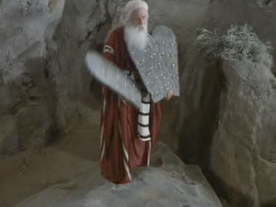
“IT in The d” presents…
The 10 commandments of networking

Slide 2
So, who are you guys?
Founded in 2001 as the “anti-group” (see: didn’t like any groups)
Re-branded in 2014 as solely “IT in the D”
Run by 3 guys (The Sales Guy, The Geek, and The Voice Of Reason)
Over 5,500 members on LinkedIn
Over 2,000 unique visitors and 8,000 page views daily at ITinTheD.com
IT in the D podcast listened to by over 200,000 people per episode
Over 120 jobs fulfilled through our meetings
100% grassroots
No guest speakers, name selling, forced sales pitches
Featured in CNN/Money Magazine, WJBK (FOX), WDIV (NBC), WXYT (ABC), 96.3 WDVD, Oakland Press, MLive.com, Detroit Free Press…
2010 CBS People’s Choice Blogger of the Year Award (Life section)

Slide 3
So, who areN’t you guys?
Ninjas, Experts, Gurus or Life Coaches
Trying to get you to pay $300 so I can re-write your resume
Trying to sell you something afterward
Someone who will sugarcoat the truth

Slide 4
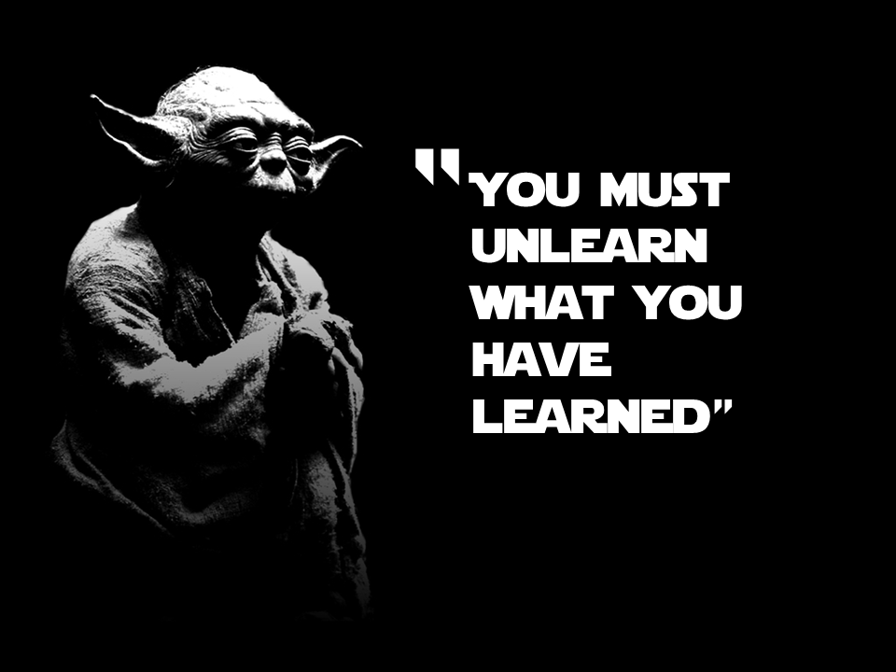
In the beginning…

Slide 5
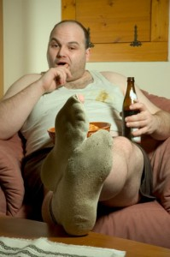
I. Thou Shall Understand The Importance of Networking
It is a relationship
Get off the couch!
Show up
Be consistent
Don’t network only when you need something
See: You missed the point

Slide 6
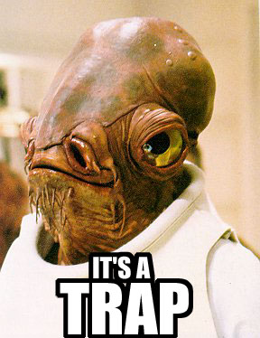
II. Beware of False Prophets
They are everywhere!
Find out which events suck
Don’t pay $20 to listen to someone talk about how awesome Twitter is
Ask questions to the organizers about what you can expect
Don’t give up your contact list to a Florist (see: BNI)
If it isn’t for you, leave

Slide 7
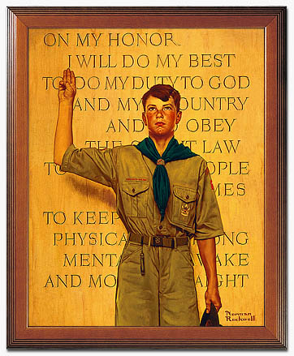
III. Thou Shall Be Prepared
Treat it like an interview
Have cards
(see: Vistaprint.com)
Don’t bring resumes
Dress appropriately for the venue
Have a focused message
Not - “I do everything!”
Know your audience

Slide 8
IV. Thou Shall Not Have Anxiety
Everyone is in the same boat
Travel in pairs
Introduce yourself to the event organizers
Don’t feel you need to meet everyone in 15 minutes
Relax

Slide 9
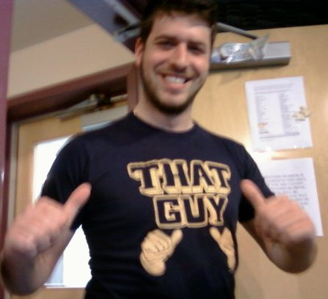
V. Thou Shall Not Be “That Guy”
Ever.
Overbearing sales guy
Arrogant IT guy
Drunk guy
Stalker guy
Annoying voicemail guy
The sense of entitlement guy
The b*llsh*t generator
MLM guy

Slide 10
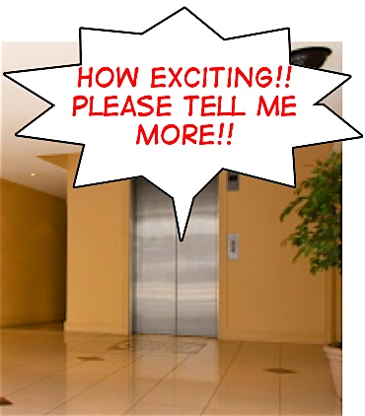
VI. Thou Shall Not Have an Elevator Pitch
Just don’t.
Know your audience
Pitch should be different for CFO vs. recruiter vs. peer vs. sales guy
“My name is Bob with Cisco, what do you do?”
Anything more than 10 seconds and you’ve lost them

Slide 11
VII. Thou Shall Not Lie
It’s a small world after all
No need to exaggerate
People will find out quickly, and the word will spread
Don’t be ashamed of who you are
See: I’m trying to get into the industry

Slide 12
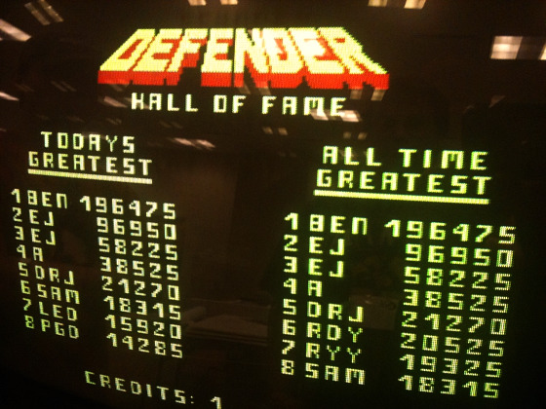
VIII. Thou Shall Understand Quality vs. Quantity
Networking is NOT a video game
No prize for the most business cards
No awards for the most LinkedIn connections
Only have time in your life for roughly 700 people
Tier your network and make contact appropriately

Slide 13
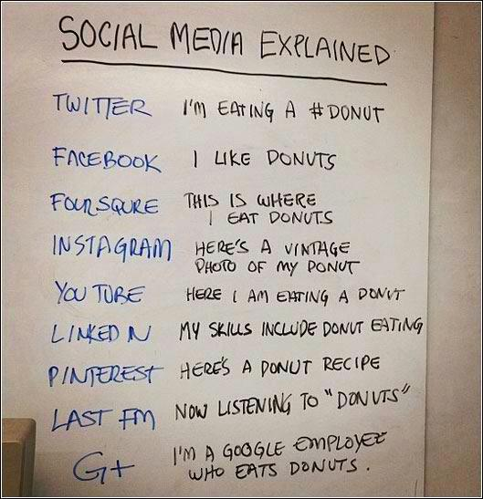
IX. Thou Shall Understand Social Media
They are all not the same
Facebook is your living room
Linkedin is your office
Twitter is…well, we still don’t know
Leave your political views at home
Everything you write is there forever
Stop Twittering yourself

Slide 14
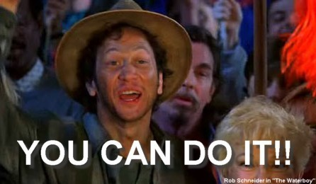
X. Thou Shall Follow Up
The key to networking
Send a thank you note the next day
Don’t be overbearing
Send a Linkedin request
Ask for coffee if you think the relationship will be mutually beneficial
Help regardless of reciprocation
Remember karma

Slide 15
Call to Action…
SHOW UP
PREPARE
ENGAGE
KNOW YOUR GOAL
FOLLOW UP
KARMA

Slide 16
If you’re looking…
Casual Networking Event
Twice each month
Check our website, Facebook page or Meetup group
Pink Slip Party
Twice per year
March and September
Be there

Slide 17
THANK YOU…

