Slide 1
Granny Squares
Crochet 102
Penguicon 2019

Slide 2
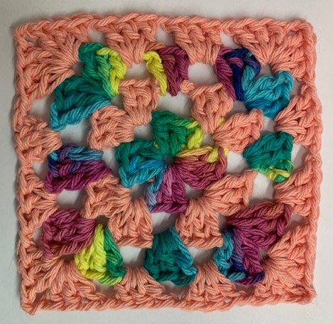
Materials:
Yarn
Crochet Hook
Scissors
Needle for Weaving in Ends
Mist Bottle (Optional)
Blocking Mat and Pins (Optional)

Slide 3
Slip knot
Step 1

Slide 4
Chain Four
Step 2

Slide 5
Slip Stitch into first stitch
Step 3a

Slide 6
…to Form a loop
Step 3b

Slide 7
Chain Three
Step 4

Slide 8
Crochet two Double Crochets in the Loop (your first “Shell”)
Step 5

Slide 9
Chain two
Step 6

Slide 10
Second Shell: three Double Crochets into the Loop
Step 7

Slide 11
Chain two
Step 8

Slide 12
Repeat Steps 7 & 8 two more times (you have four shells)
Step 9

Slide 13
Slip Stitch into 3rd Stitch in the chain three
Step 10

Slide 14
Changing Yarn! Pull through old yarn and cut tail
Step 11

Slide 15
Join New Yarn On Any Corner (leaving a tail to weave in) & chain three
Step 12

Slide 16
Finish the Shell and Chain two
Step 13

Slide 17
One more Shell to complete the corner
Step 14

Slide 18
On the sides, chain one between the shells
Step 15

Slide 19
Two More Shells on Next corner Note: for corners, Always chain two between the shells
Step 16

Slide 20
Chain one (it’s a side)
Step 17

Slide 21
Repeat Steps 16 & 17 for the two remaining corners (shell, chain two, shell for the corners; while chaining one for each side)
Step 18

Slide 22
Join the Chain one and First shell of this row by slip stitching into the third stitch on the chain three
Step 19

Slide 23
New Yarn! Join and Chain three in any gap between shells (I’m starting on a side)
Step 20

Slide 24
Complete the shell and chain one (it’s a side!)
Step 21

Slide 25
Keep at it: two shells in each corner separated by a chain two, one shell in each side gap surrounded by a chain one
Step 22

Slide 26
Complete this row by joining with a slip stitch into your chain three and pulling it through to change Yarn again!
Step 23

Slide 27
Join new yarn in any Gap (I’m starting on a side again). Complete the shell and chain one.
Step 24

Slide 28
Follow the Pattern stated in Step 22
Step 25

Slide 29
Slip Stitch to Join and pull through
Step 26

Slide 30
Weave the Ends in Recommended: mist and block
Step 27

