Slide 1
How to work with the Disabled: Autism
"People with a disability are most known for their nobility."

Slide 2
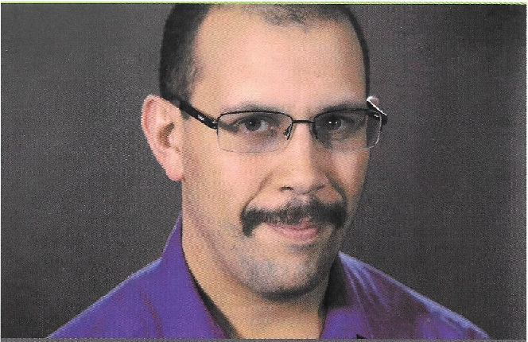
Presenter
Ian Sterrett
Data Analyst
Contact info:
Ian.sterrett82@gmail.com
www.ianformed.com

Slide 3
Presenter
Greg Walters
IT Consultant
Contact info:
Gregory.Robert.Walters@gmail.com

Slide 4
Autism: The What, the How and the Not So Much
What is Autism(High, Medium, Low)?
Stories
Cyberbullying
Realities and Myths
Commandments
Q &A

Slide 5
What is Autism?
High Functioning
Medium Functioning
Low Functioning

Slide 6
Stories
Have you dealt with someone with Autism and how did you deal with them?
Stories from presenters
Nuri
Tammy
Greg
Ian

Slide 7
Cyberbullying
Michigan recently passed laws about cyber-bullying and it may change the face of social media and how people interact. What in Cyber-bullying should be stopped?

Slide 8
Realities and Myths
Do people with Autism like:
To work?
To have a conversation?
Going to parties to meet strangers?
Lights?
Games?
Yes, love to stay busy
Yes
Yes, as long as it’s controlled, no sensory overload.
Most lights don’t induce seizures. Bright lights depends on the person.
Be more specific. I like role playing games(RPG’s) the most.

Slide 9
Realities and Myths(part 2)
Are people with Autism:
Efficient and productive workers?
Use less communication than others?
Is it safe to assume that because of their communication, to speak for them?
Able to work a customer service job?
Are people with Autism known for having seizures?
Yes
Depends on the person.
No. Ask them first.
Yes. May not even need a script.
Some do have seizures.

Slide 10
People with Disabilities Statistics:
In 2017, 5.9% of people with a disability and a bachelor’s degree or higher were unemployed compared with 2.2% of the non-disabled population in the US¹
Unemployment in 2017
11.5 % people with disabilities¹
4.7 % people w/o disabilities
Adults with disabilities spend $200 billion annually, which is twice that of the teen market.
15 Million People with Disabilities are of working age in the US¹
Temporarily or Permanently, almost everyone will experience living w/ disability at some time in their life
1 in 4
(61 Million)
people in the US have a disability²
People with disabilities represents one of the largest diversity demographics in the US¹
Source: ¹ US Bureau of Labor Statistics 2018 Release
Source: ²CDC release: https://www.cdc.gov/media/releases/2018/p0816-disability.html

Slide 11
Commandments
Thou must:
Network with others in general
Understand that disability isn’t an us vs them problem. It’s an understanding each other problem.

