Slide 1
Hacking Your Writing and Editing Toolbox
Scott Favre
Penguicon 2015

Slide 2
Boring Overview
Office Addon Basics
Our Architecture
Coding
30 Second Dance Party with DJ Baby Groot (time permitting)
Source: https://github.com/scottfavre/RedLine

Slide 3
What can we do?
Full access to the document
Full access to the ribbon
Side panels and dialogs
Document- and Application-level Addons
Magic
Ponies (possibly)
Rainbows (some assembly required)

Slide 4
Prereqs
Visual Studio 2013 (Professional or better, because MS sucks)
Select “MS Office Developer Tools” during setup
Word 2010 (2013 works, but has a different version of the SDK)

Slide 5
Requirements
Search for adverbs
Search for “crutch” words such as: started, began, saw, thought, etc.
Move between flagged words (next/prev)
Flagged words are sorted by position in the document (so that review only takes one pass)

Slide 6
Out of Scope
Curated list of crutch words:
Add directly from document context menu
Remove from crutch list
Per-author lists
Homonym search (there are a lot more than you think!)
Proper noun spell check (for Fantasy/SciFi)
Stats gathering

Slide 7
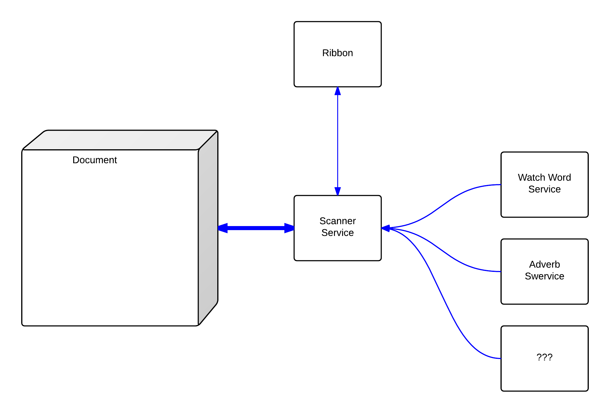
Addon Architecture

Slide 8
Code!
code code code code code code code code code code code code code code code code code code code code code code code code code code code code code code code code code code code code code code code code code code code code code code code code code code code code code code code code code code code code code code code code code code code code code code code code code code code code code code code code code code code code code code code code code code code code code code code code code code code code code code code code code code code code code code code code code code code code code code code code code code code code code code code code code code code code code code code code code code code code code code code code code code code code code code code code code code code code code code code code code code code code code code code code code code code code code code code code code code code code code code code code code code code code code code code code code code code code code code code code code code code code code code code code code code code code code code code code code code code code code code code code code code code code code code code code code code code code code code code code code code code code code code code code code code code code code code code code code code code code code code code code code code code code code code code code code code code code code code code code code code code code code code code code code code code code code code code code code code code code code code code code code code code code code code code code code code code code code code code code code code code code code code code code code code code code code code code code
test, cry, drink
code code code code code code code code code code code code code code code code code code code code code code code code code code code code code code code code code code code code code code code code code code code code code code code code code code code code code code code code code code code code code code code code code code code code code code code code code code code code code code code code code code code code code code code code code code code code code code code code code code code code code code code code code code code code code code code code code code code code code code code code code code code code code code code code code code code code code code code code code code code code code code code code code code code code code code code code code code code code code code code code code code code code code code code code code code code code code code code code code code code code code code code code code code code code code

Slide 9
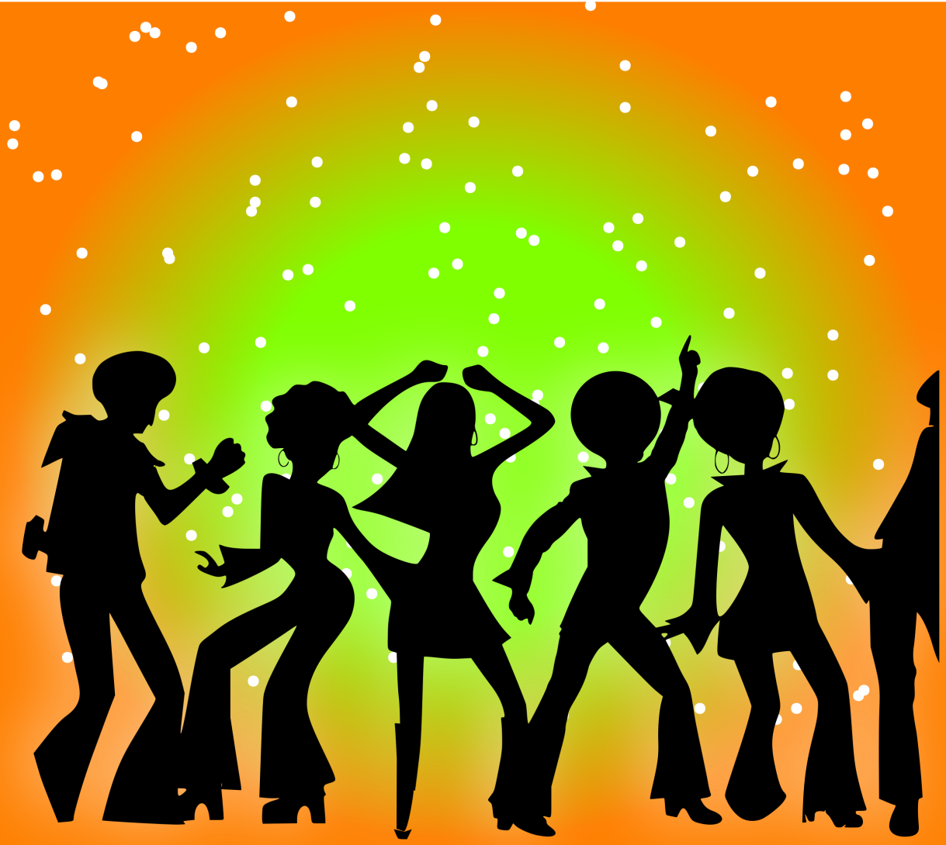
DANCE PARTY!
https://github.com/scottfavre/RedLine

