Slide 1
Feline Nutrition and Behavior 101
With Cassandra Morgan
Feline Nutrition and Behavior Consultant
Zen Cat Feline Behavior Consulting

Slide 2
Cats in History
We first think of cats in history as being domesticated by the ancient Egyptians.
However, in 2004, an archaeological dig revealed a Neolithic grave with a human lovingly buried with their cat.
This significantly moves the previous estimated time line where cats were thought to have been domesticated in China 5,300 years ago to more than 9,500 years ago.
(yay science)
The time when cats were domesticated doesn’t really matter, however.
What matters is WHY

Slide 3
The Domestication of Felis catus
It’s very important to note that humans did not domesticate cats.
Cats allowed themselves to become friendly with humans, because they saw it as an end to their means.
Cats were first drawn to human settlements for the same reason their prey was drawn there – FOOD and SHELTER.
Rodents saw a schmorgashborde of food stored in one place.
Cats saw a schmorgashborde of rodents in one place.
While being one of the most efficient warm-blooded killing machines on the planet, cats find themselves as both Predator and Prey
While cats may kill rodents, birds, lizards, insects, etc
They also find themselves the victims to larger predators
In exchange for killing the rodents in the human settlements, cats were given a safe place to live.

Slide 4
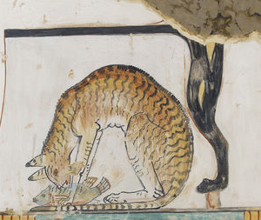
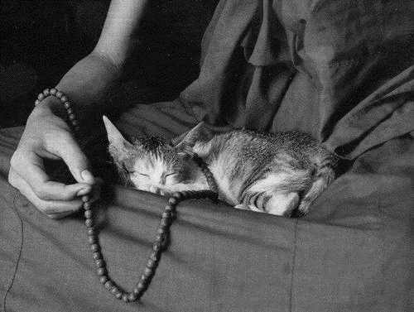
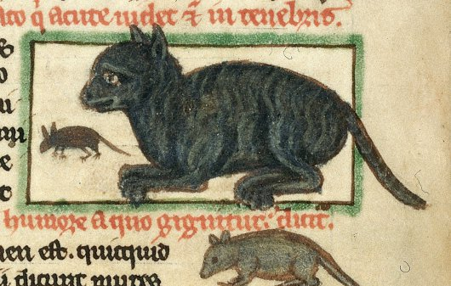
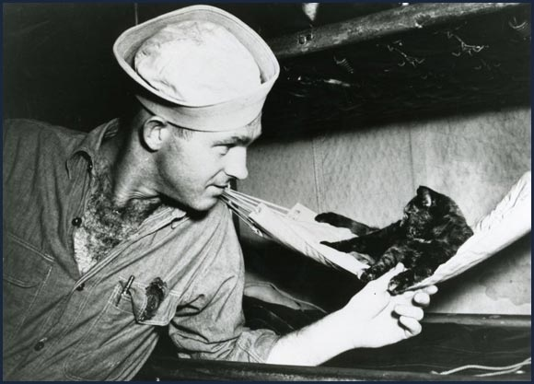
The Evolution of Domestication
Ancient Egyptians
Buddhist Monks
Medieval Farmers
Sailors

Slide 5
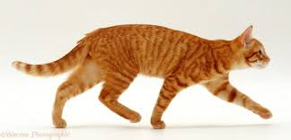
Predator and Prey

Slide 6
What’s in it for Me?
Every decision a cat makes is based on 1 thought:
HOW WILL I SURVIVE TODAY?
As a PREDATOR:
Survival means finding food efficiently
As PREY:
Survival means avoiding other predators
Dogs live to please, Cats live to survive
When you want a cat to do something, there must be something in it for them

Slide 7
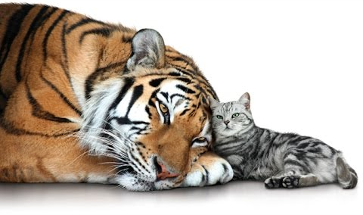
I Too Am A Carnivore

Slide 8
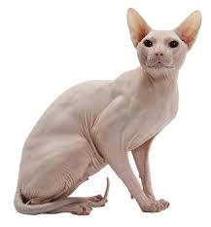
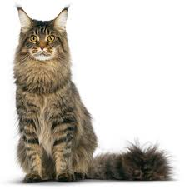
My Ancestory.Cat
More Closely Related
THAN
Boxer is to Pitbull

Slide 9
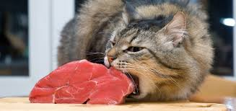
Obligate Carnivore
Cats are Obligate Carnivores
They are unable to derive proper nutrients from plant matter
The only non-animal based food they eat is what’s in the stomachs of their prey

Slide 10
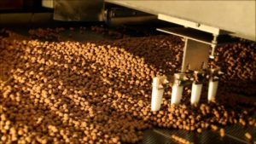
How Pet Food is Made
Pet Kibble on Conveyor
Cereal on Conveyor
Ingredients are mixed together, dolloped onto a conveyor by a machine, and sent through a giant oven.
After cooking, the kibble is sent on to the flavoring and coloring stations.
Granted, not all kibble contains artificial color, but all of it has the flavor sprayed on the outside when complete.

Slide 11
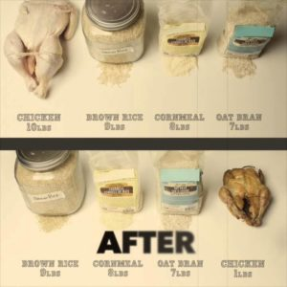
How to Read a Pet Food Label
Pet Food companies list ingredients by weight BEFORE cooking, not by quantity.
Best Results Canned:
Minimum Crude Protein 12%
Minimum Moisture Content 70%
Best Results Kibble:
Minimum Crude Protein 32%

Slide 12
Limited Ingredient/Grain-Free Diets
Beware of ingredients like
Sweet Potato
Rice
Potato
Pea Starch
Many foods use these as more expensive fillers, but they often contain a minimum of 45% carbohydrate, which is several times more than what any cat could need on a daily basis.
Cats need to derive at least 70% of their water intake from their food.
Most cats that are fed kibble-only diets are living in a semi-dehydrated state, especially since many artificial colorings are diuretics.
This is why the number one medical cause of death in cats is Kidney and Renal issues, and why cats seem so prone to Urinary Tract Infections.
Diet is a leading cause to many health issues which can eventually lead to litter box aversion, and is the number one reason cats are surrendered to shelters from a once loving home.

Slide 13
Sources to Consider
“Idiosyncratic nutrient requirements of cats appear to be diet-induced evolutionary adaptions” by JG Morris of UC Davis
Pottenger’s Cats – great YouTube Video: “Pottengers Cats-Diet Will Affect Future Generations”
www.LongLivingPets.com (18 years into the 30 year study)
“Raw Meat-Based Diets in Dogs and Cats” -Veterinary Sciences 2017
“Raw meat based diet influences faecal microbiome and end products of fermentation in healthy dogs” – BMC Veterinary Research, 13, 65
NZ study on animal nutrition, by AgResearch, Massey University (published in Life, Bio and Health Sciences journal)
“Perceptions, practices, and consequences associated with foodborne pathogens and the feeding of raw meat to dogs” – Canadian Veterinary Journal
“The Biologically Appropriate Food Concept and the Dietary Needs of Dogs and Cats” – Champion PetFoods (Orijen White Paper)
“The Biologically Appropriate Food Concept and the Dietary Needs of Dogs and Cats” – Veterinary Sciences Journal

Slide 14
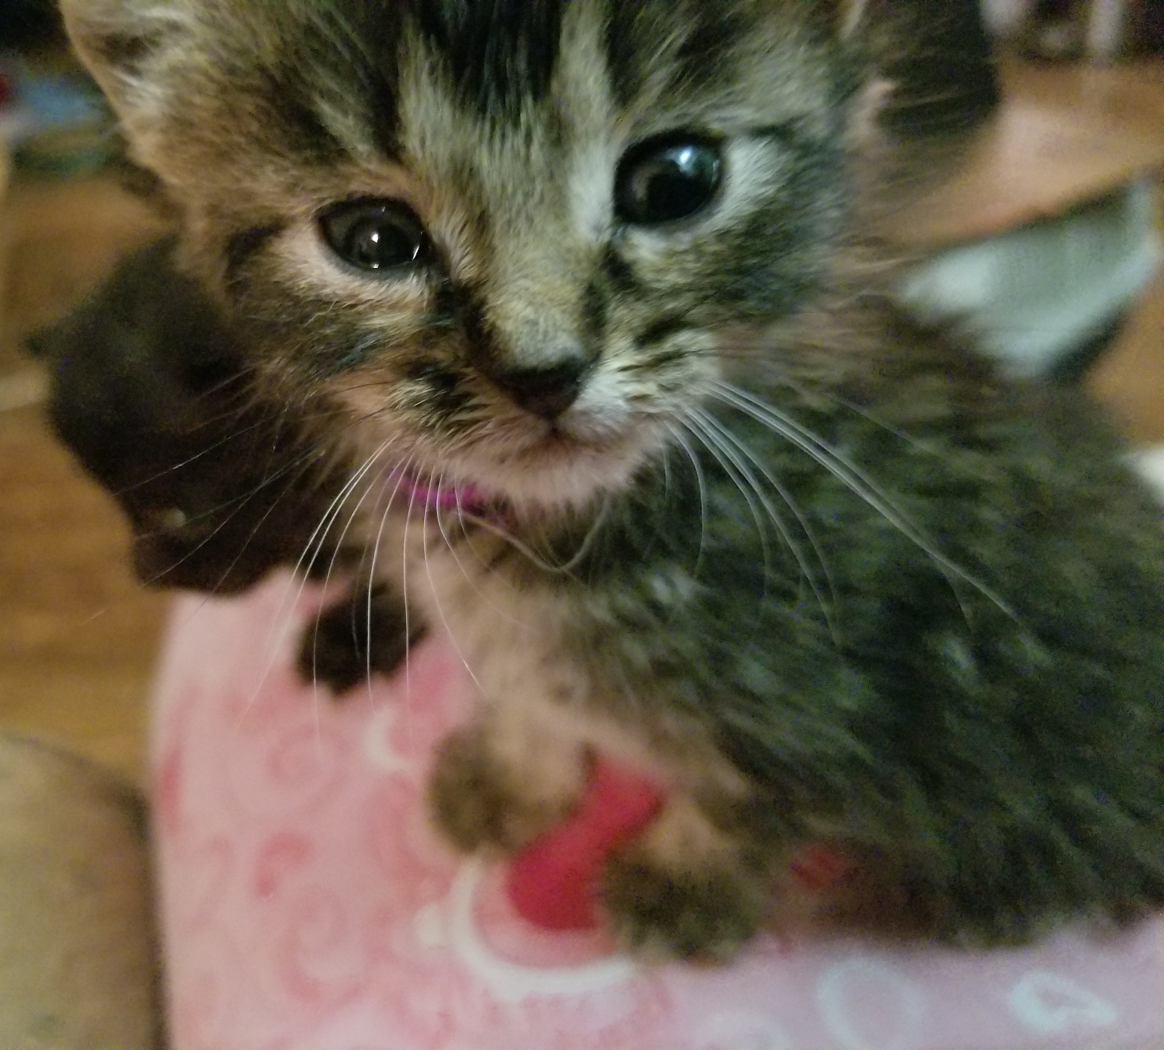
Questions, Hoomans?

