Slide 1
Crash Course in Super Basic Electronics
What you need to get you started

Slide 2
What makes electricity work?
-
Notes:
Break it down to an atomic level

Slide 3
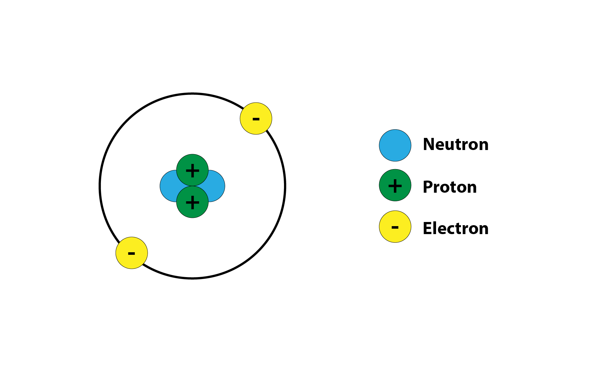
Structure of an Atom

Slide 4
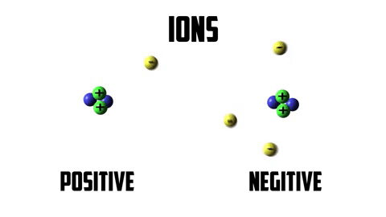
Atoms gain or lose an electron and become a charged ion.
Ions with extra electrons = Negatively charged because they have more negative charge.
Ions with fewer electrons = Postitively charged = less negative charge
Atoms want to be neutral
Opposing forces are drawn together, like magnets
Ions are always trying to lose their extra electron or gain their missing electron
Because of this...

Slide 5
Electrons move (or flow) from ion to ion.
Positively charged ions are drawn to negatively charged ions and pass electrons to each other.
Ions try to return to neutral so constantly passing electrons.
This flow of electrons is ELECTRICITY!
Also called
electron flow
electromotive force (EMF)

Slide 6
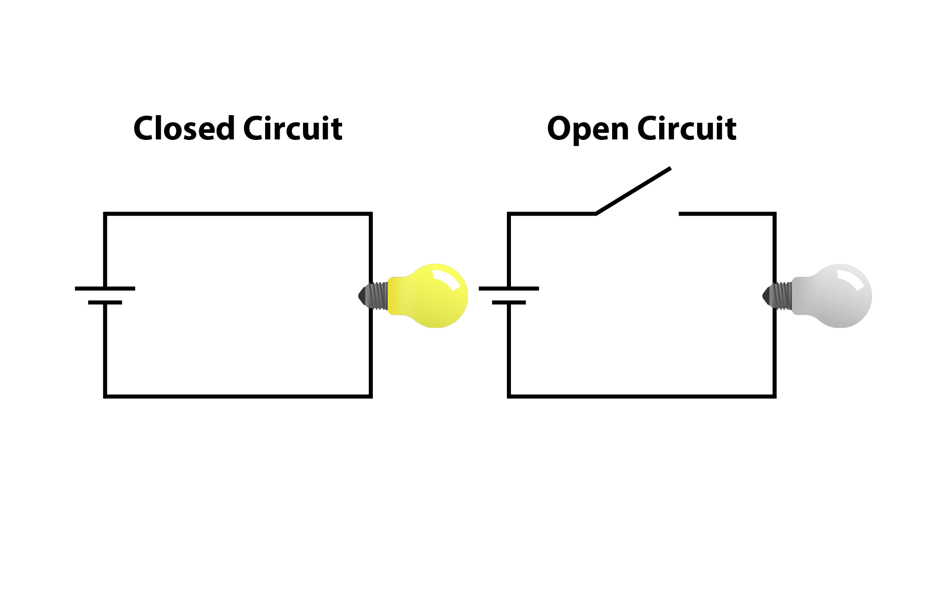
Open vs Closed Circuits
Notes:
Electricity needs positive and negative to attract in order to flow.
Explain circuits. O vs | on switches.
Electricity flows in a circle or circuit.

Slide 7
Questions?

Slide 8
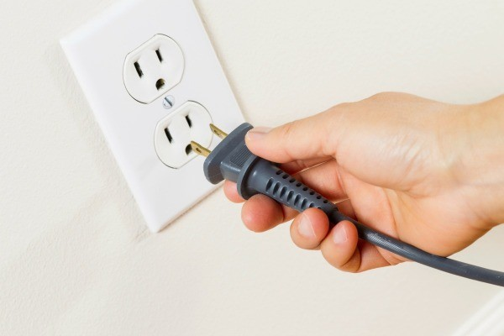
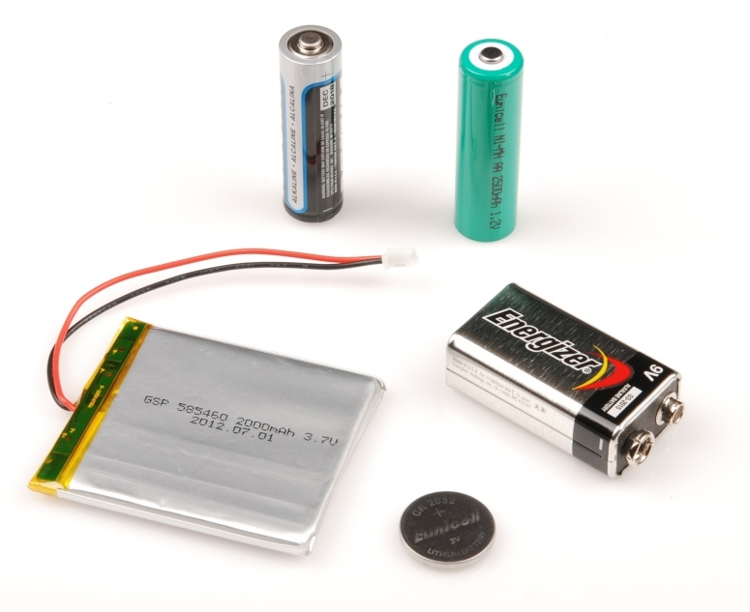
Where does electricity come from?
AC vs DC
Notes:
AC = Alternating Current. Electricity flows in both directions. In waves. 120V
DC = flows in one direction. Is constant. Volts Unknown.
Most hobby electronics projects use DC current. If plugging into the wall, AC is converted to DC.

Slide 9
Using Electricity
Conductive
Insulative
Metal: Copper, Aluminum, Steel, Iron
Application/Uses
Wire - inside
copper tape
Aluminum foil
Neodymium magnets
Conductive thread
Plastic, Wood, Rubber
Application/Uses
Wire covering
Cases
Electrical tape
Notes:
“The path of least resistance” Exactly how electricity works. Will always flow through whatever material has the least resistance. Won’t flow through anything with too much resistance.
Make circuits using conductive materials, using insulative materials to make them safe.

Slide 10
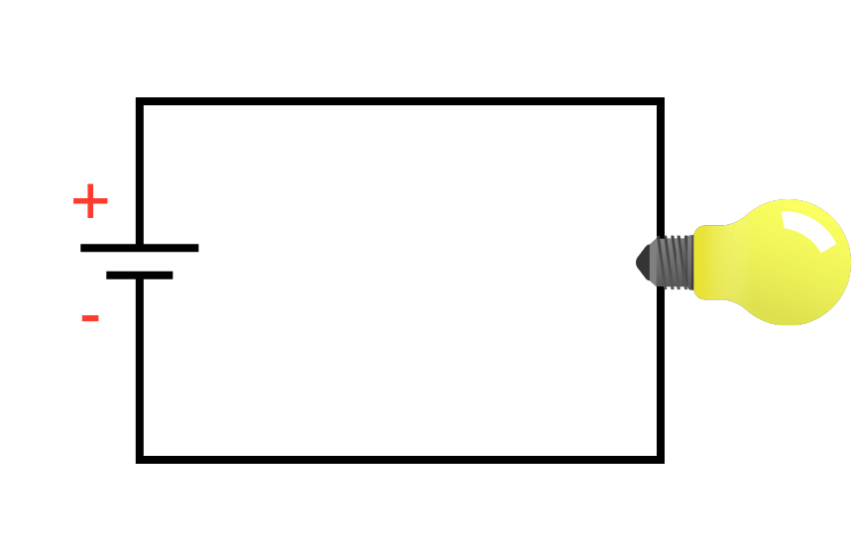
How to use electricity.
AC
DC
Notes:
To use electricity, connect an electrical component (like an LED) between the positive and negative of the power supply.
Electricity wants to flow between them, so it will flow through the object, turning it on.
Battery or plug referred to as “Power Supply”

Slide 11
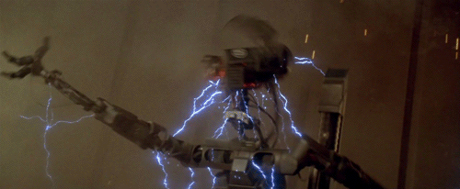
Careful not to short your circuit!
Notes:
You never want to connect the positive of your power supply, to the negative.
A circuit can be shorted by giving the power a “shortcut”. This can connect the postive directly to the negative, or bypass component that limits the amount of power supplied to other components. This can cause a component to blow or break and not work anymore.

Slide 12
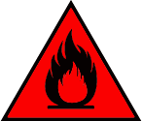
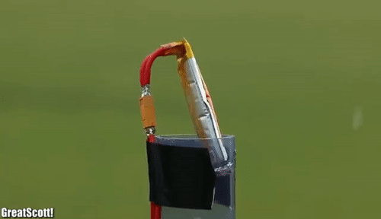
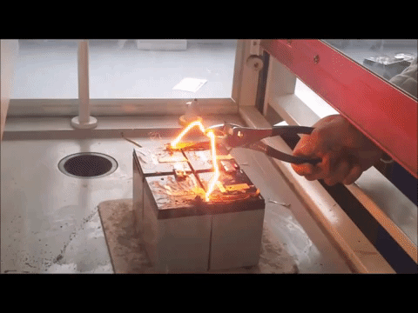
Careful not to short your circuit!
Notes:
In worst cases, this can cause your battery to blow up. Very dangerous.

Slide 13
Speaking of fire...choosing the right WIRE
If your wire is too small/skinny for your circuit, it could get hot and burn.
Solution: Use a diameter wire that is rated for the voltage and current of your circuit.
Wire comes in solid-core and stranded.
Solid-core: holds shape when bent, breaks after too much bending
Stranded: flexible and durable, does not hold its shape
Notes:
Wire often has a rating written on the sleeve telling you the max voltage and current it can handle.
Wire that has too much electricity being pushed through it becomes HOT and can BURN UP.

Slide 14
Questions?

Slide 15
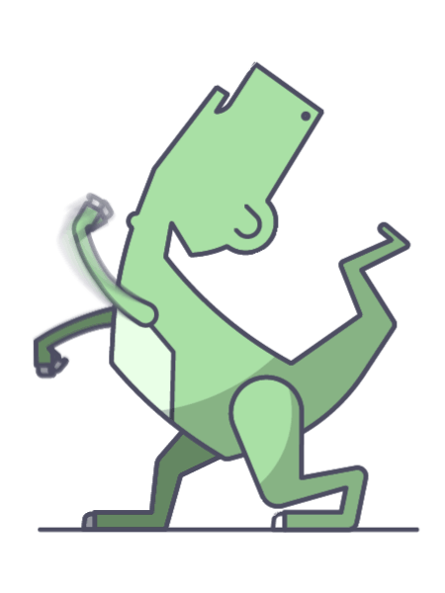
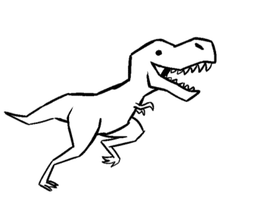
We’re about to get serious.
Notes:
For those of you that hate math, I’m sorry. This requires some math. But I’ll try to make it less painful.

Slide 16
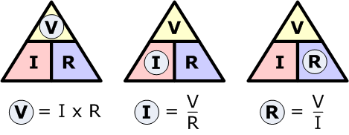
Ohm’s Law
Notes:
There’s more to making circuits than just connecting things together.
Every circuit has a balance of Voltage, Current, and Resistance.
Components each have their own rating limit. Other components have to be added to make sure those limits are not exceeded.

Slide 17
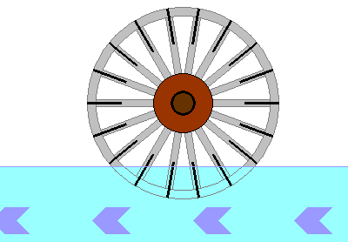
Voltage (V)
Current (a)
Resistance (Ω)
Unit of measurement:
Volts
The amount of energy potential.
Unit of measurement:
Amps (amperes)
The rate or strength of flow.
Unit of measurement:
Ohms
Anything that slows it. down or gets in the way.
Notes:
Think of it like a water wheel in a river. If the water level is too low, the wheel won’t turn. Voltage
If the water isn’t flowing fast enough, the wheel won’t turn. Current
Let’s say there is a screw holding the middle of the wheel. If we tighten it, the wheel don’t doesn’t turn as easily and the water has to work harder to make it turn. Resistance

Slide 18
Ohm’s Law
Notes:
Frequently you’ll have two known values in your circuit that you can use to find the third.

Slide 19
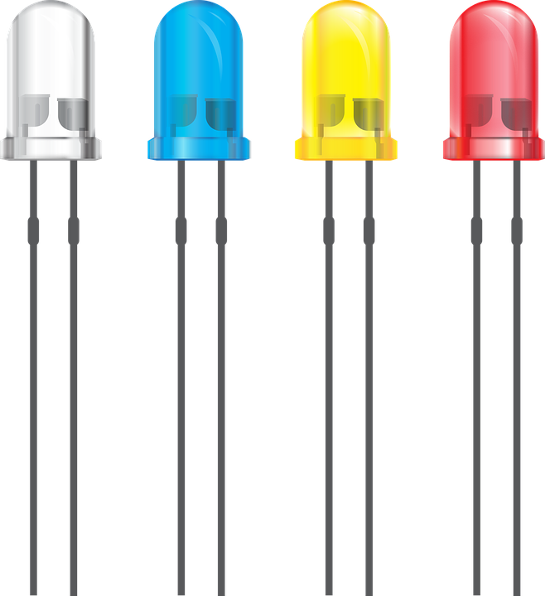
LED Limits
Voltage rating: 2.0V - 3.4V
Current rating: 20mA - 30mA
If provided too much voltage, the LED will burn out.
Need to add a resistor.
Notes:
Let’s start with an LED. Depending on the color and size, LEDs have a voltage rating of around 2-3volts and a current rating of 20-30mA.

Slide 20
Supply Voltage: Source vs Draw
Red LED has a voltage rating of 2V at 20mA.
Supply Voltage: (2) AA = 3V
Red LED voltage draws 2V
3V - 2V = 1V too much
Add a resistor to limit the amount of voltage going to LED.
Notes:
You need at least as much voltage as the part needs for it to turn on.
Sometimes they’ll turn on with a little less.
Too much voltage and the part burns up or breaks.

Slide 21
Applying Ohm’s Law
3V(batteries) - 2V(LED) = 1V
LED current limit = 2mA = .02A
How much resistance?
1V / .02A = 50Ω
You need to add a 50Ω of resistance to your circuit.
Notes:
Let’s see how we figure out how much.
Using (2)AA batteries supplying 3V.

Slide 22
Applying Ohm’s Law
Let’s try (4) batteries = 6V
6V - 2V = 4V
How much resistance?
4V/ .02A = 200Ω
You need to add a 200Ω of resistance to your circuit.
Notes:
Let’s see how we figure out how much.
Using (2)AA batteries supplying 3V.

Slide 23
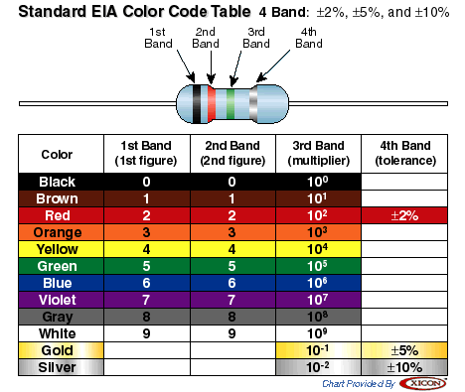
Resistor Chart
Notes:
Colored stripes - tell you the value. Check out a resistor color chart.
Resistors have a tolerance. Not always exact, +-

Slide 24
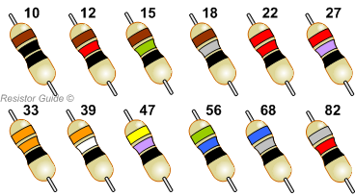
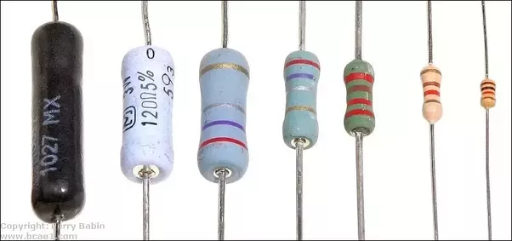
Resistors
Notes:
Resistors come in a variety of values, but not EVERY value. Left image = available values.
Right = what common resistors look like.
In 3V circuit needed 50Ω. Closest is 47Ω. That’s ok.

Slide 25
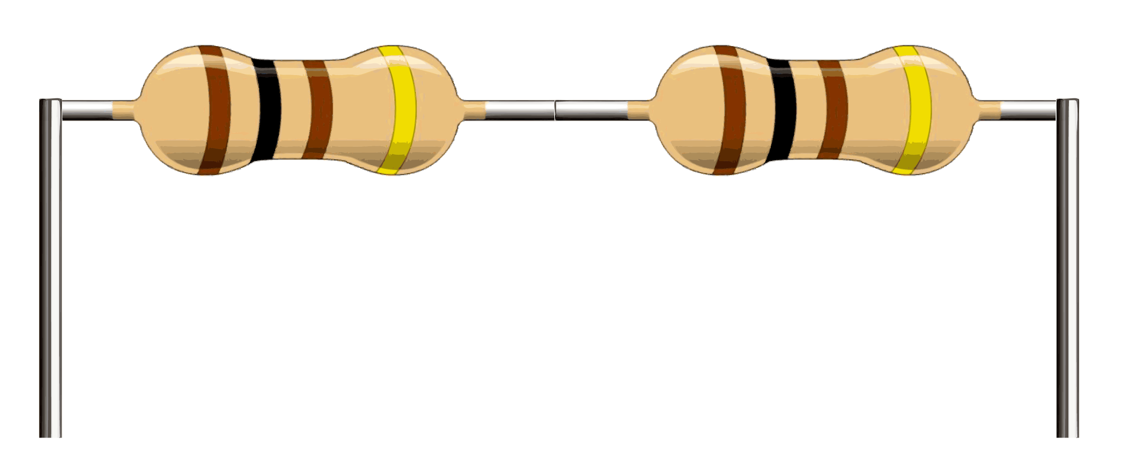
Resistor + Resistor = New Value
R₁+R₂ , etc. = Total of all values
100 + 100 = 200
1/R + 1/R, etc = 1/R
1/100 + 1/100 = 2/100
= 50
Parallel
Series
100Ω
100Ω
50Ω
100Ω + 100Ω
= 200
Notes:
Can make new values by adding two together.
You can use (2) 100Ω resistors to make both 50Ω and 200Ω, which is what you need for the circuits we talked about earlier with one LED and 3V or 6V.

Slide 26
Other components can be put in Series or Parallel
Notes:
Series circuit: voltage is split between the two. Not always evenly.
Parallel Circuit: Both lights get the same voltage.
Demonstrate.

Slide 27
Questions?

Slide 28
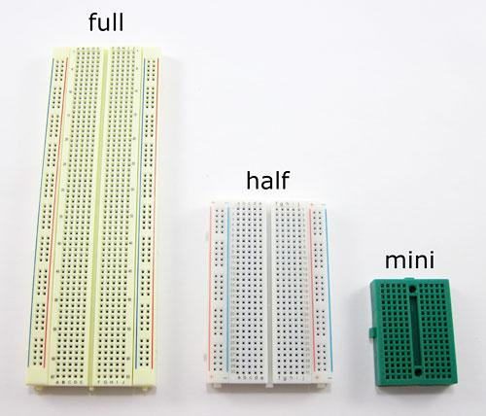
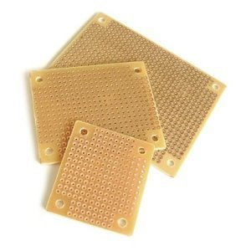
Making Circuits - Prototyping
Breadboards
Protoboard / Perfboard
Notes:
Ready to make circuits! Here’s what you need.
You can also use found materials to make prototypes. Cardboard.

Slide 29
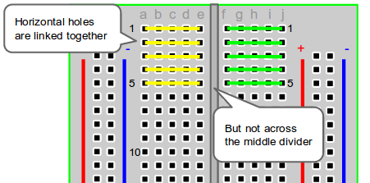
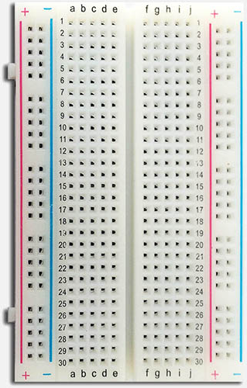
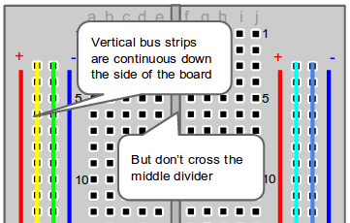
Breadboards

Slide 30
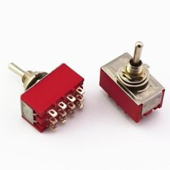
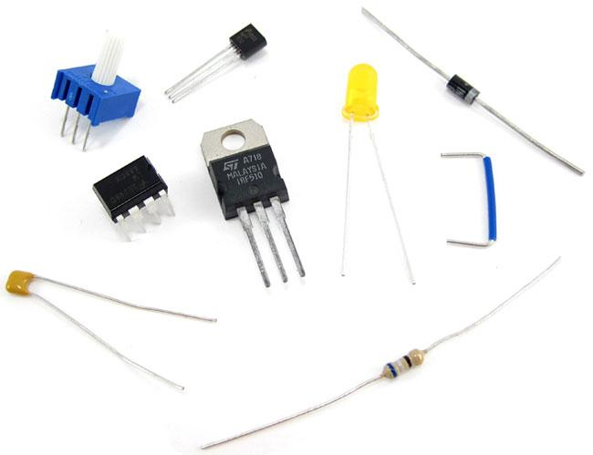
What to use with a Breadboard?
Wires or “leads” can have different spacing and be different sizes.
Correct
Wrong
Notes:
Make sure you get parts that can be used with a breadboard.

Slide 31
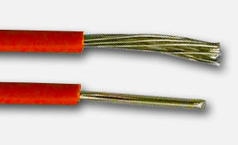
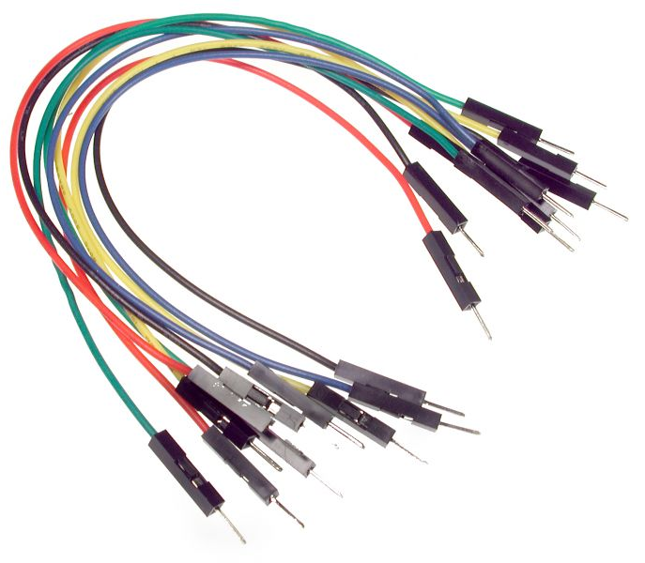
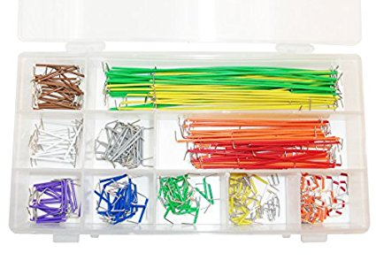
What to use with a Breadboard?
Wire
Jumper Wires
Male to Male Preformed
Stranded
Solid core
Bad
Good
Notes:
To connect your components, you’ll need wire.
Buy a spool of wire. 20 gauge is good. Too thin will flex when inserting. Too thick won’t fit.

Slide 32
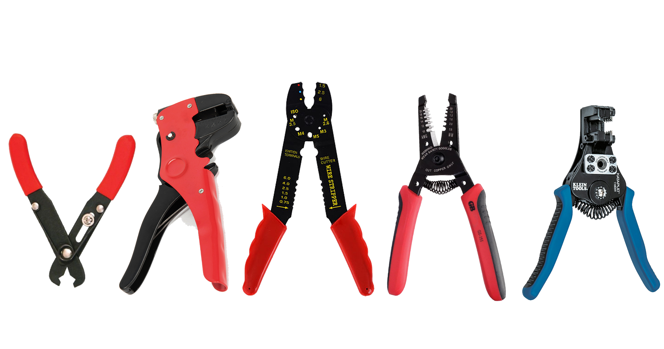
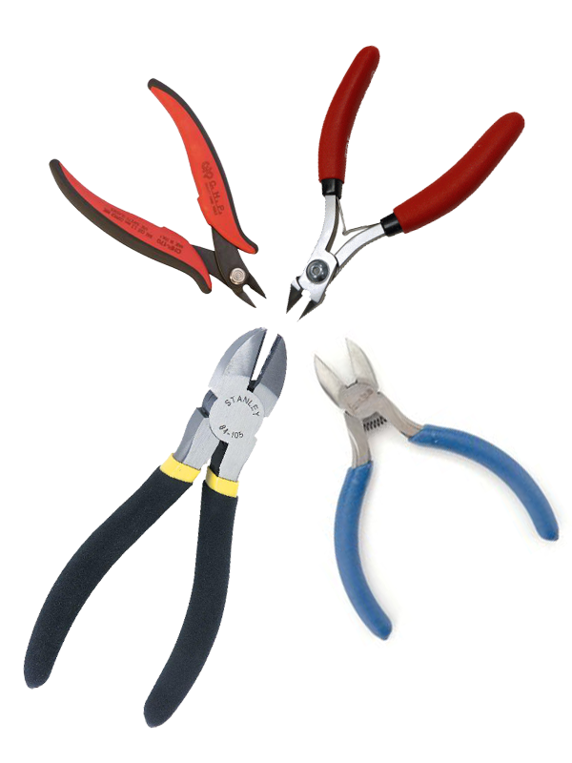
Helpful Tools
Wire Strippers
Wire Snips / Flush Cutters
Side-Angle Cutters
Not
Great
Good
Notes:
Wire Strippers: Some better than others. Some cut. Some can strip in the middle of the wire.

Slide 33
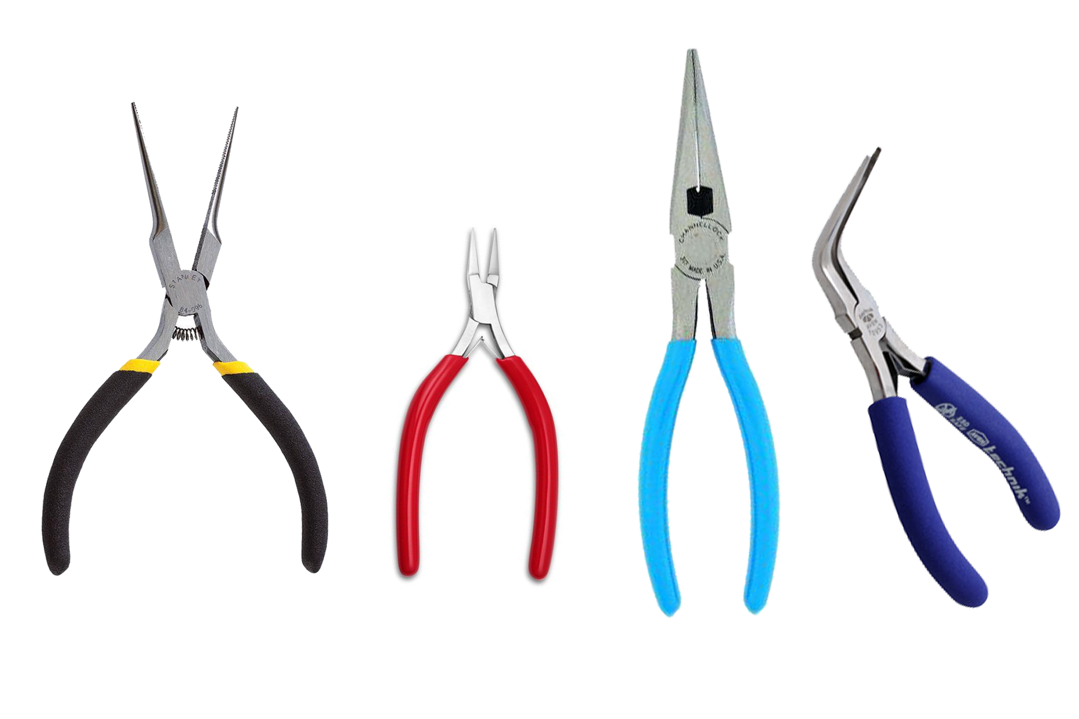
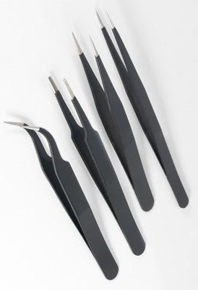
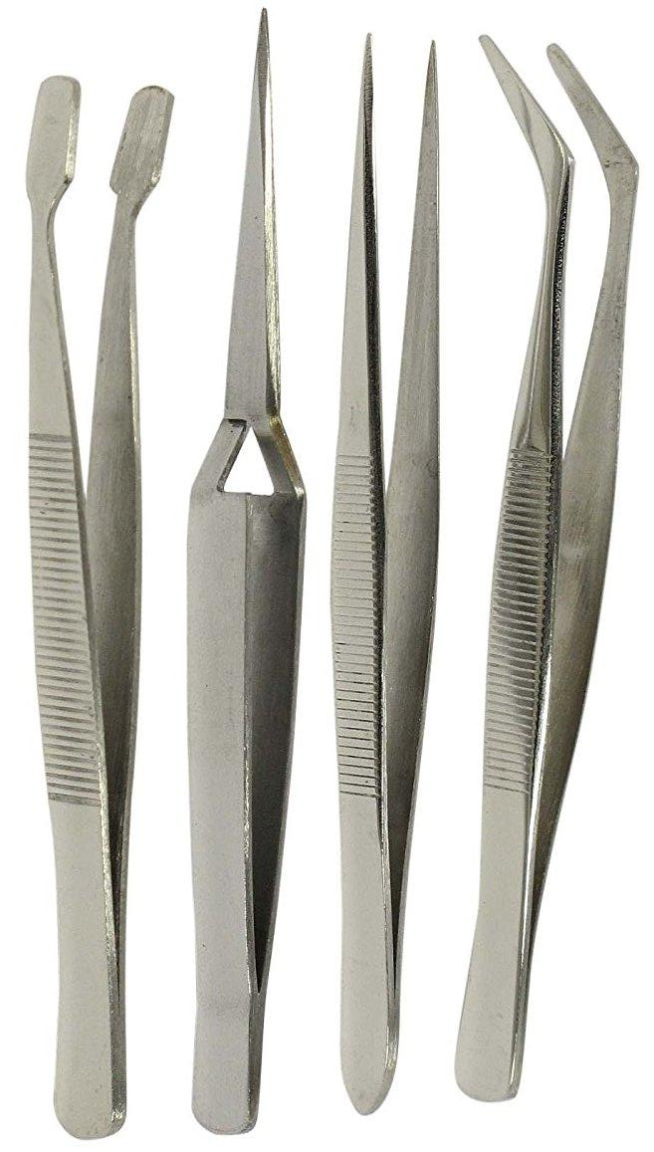
Helpful Tools
Needle Nose Pliers
Tweezers

Slide 34
Make it permanent: Perfboard & Soldering

Slide 35
Components
Notes:
All the little pieces put into circuits are called Components.

Slide 36
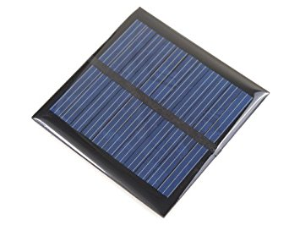
Supply Voltage: Batteries
Batteries
Alkaline: AA, AAA, C, D, button cell
Rechargeable: Ni-Cd, Li-ion, LiPo, NiMH
Other Sources
Solar cells
Natural: Wind, solar, water
Notes:
For your circuit to work, you need a power source.
Most commonly we use batteries.
Once you have a source to supply the electricity you need, you’ll want to be able to control it by turning it on and off.
Batteries are Polarized (+-).
Need to be hooked up in the correct direction to work. Lots of components are polarized, but not all.

Slide 37
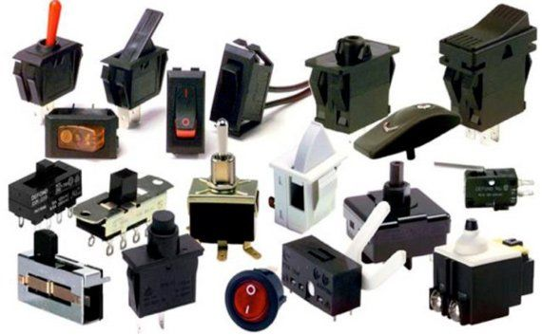
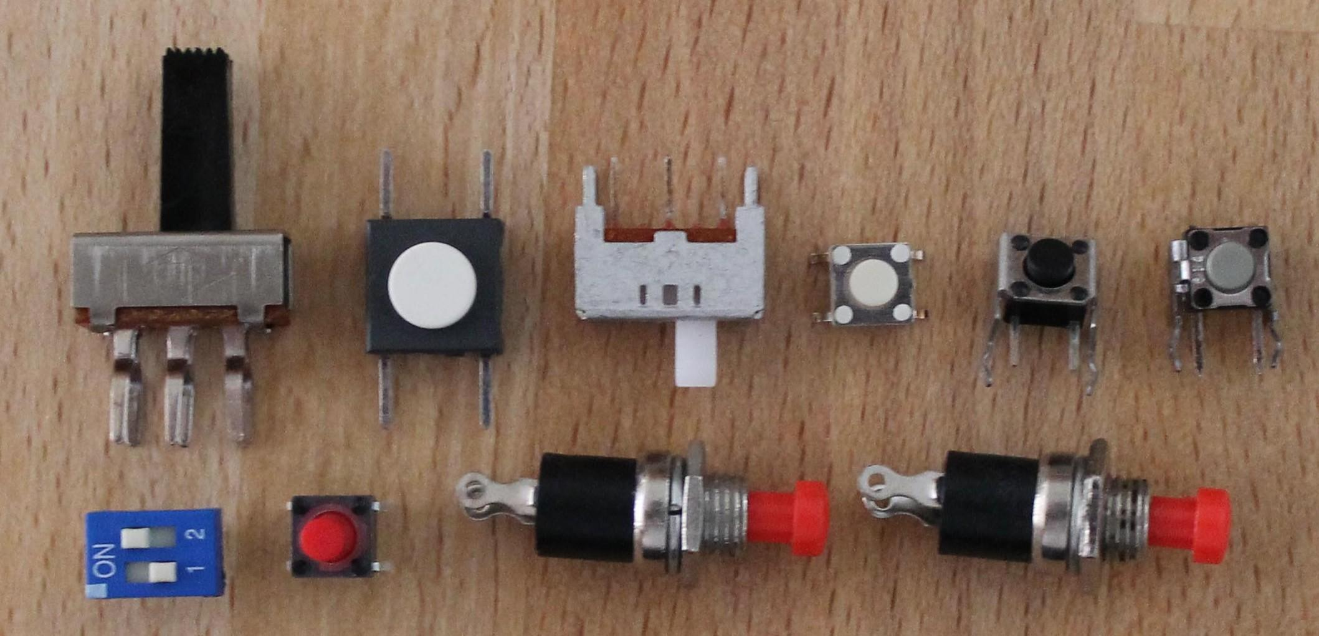
Opening & Closing the Circuit
Buttons
Switches
Notes:
Often a physical connection is made
Switches can have more than one component connected to them.
More positions than just On/Off

Slide 38
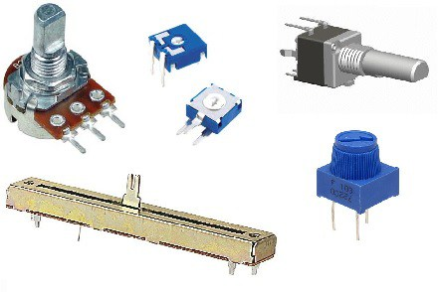
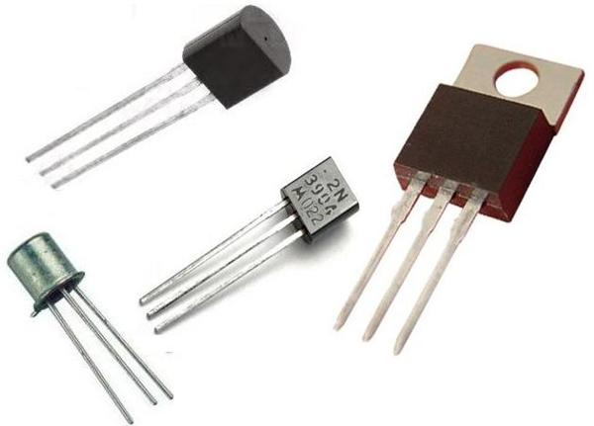
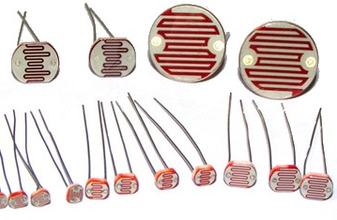
Opening & Closing the Circuit
Potentiometers
Transistors
Photoresistors
Notes:
Transistors: Switch on/off with signal.
Potentiometer: like a volume control for electricity. Often a resistor that goes from 0 ohms to a max rating. 1k ohm and 10k ohm are common.
Photoresistors: Resistor depends on the amount of light. Closed to Open

Slide 39
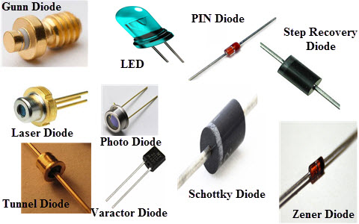
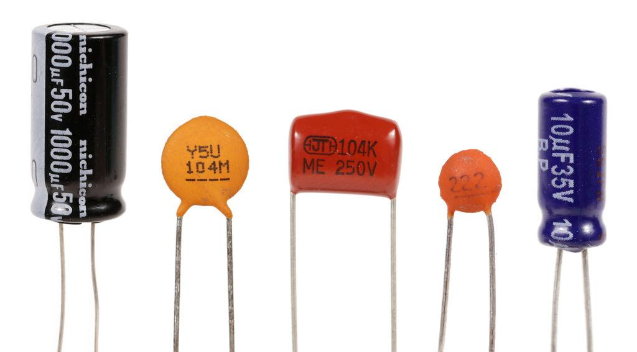
Voltage & Current Modifiers
Capacitors
Can be charged and release voltage. Does not create voltage like a battery.
Diodes
Only allows current to flow through in one direction.
Notes:
Some capacitors are polarized some not.
Diodes are polarized
Explain how to tell and what that means. Power won’t flow if hooked up backwards.

Slide 40
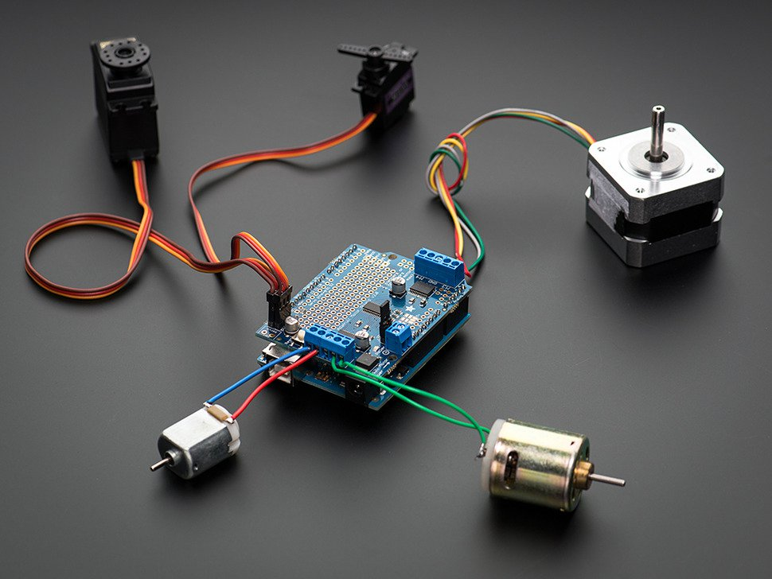
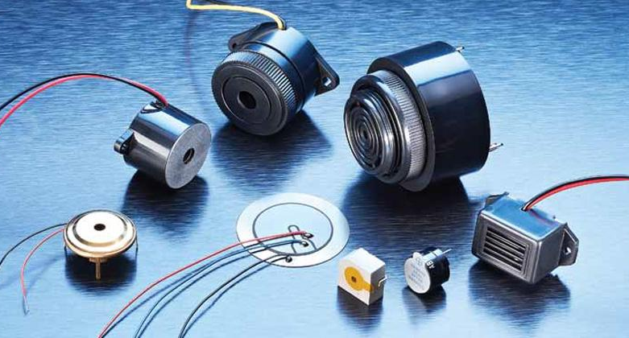
Turn it On
Motors
C Motors, Stepper Motors, Servos,
Fans
Sound
Buzzers
Speakers (requires amplifier)
Notes:
Often a physical connection is made

Slide 41
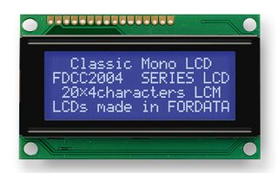
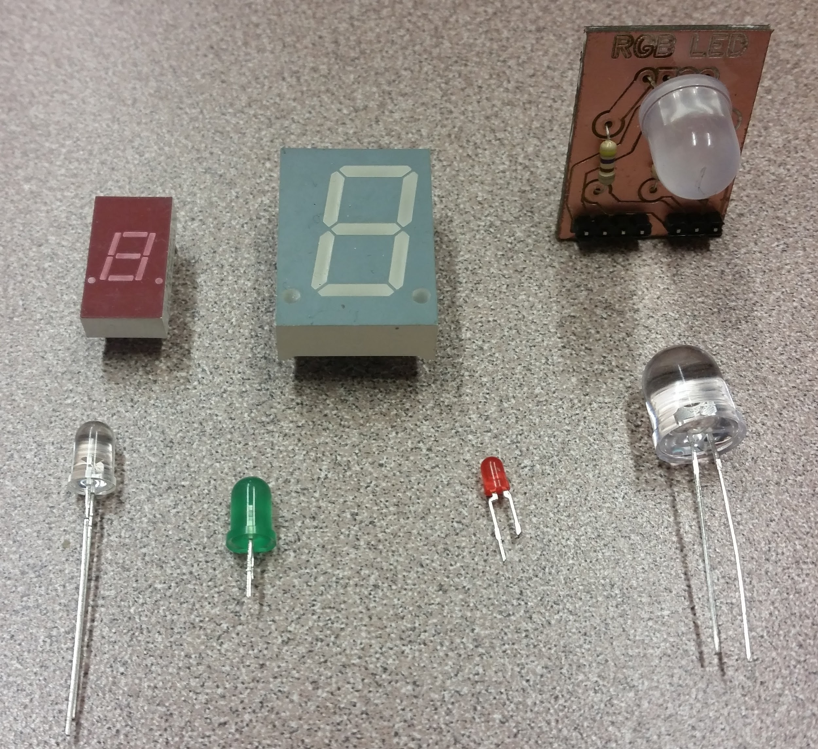
Turn it On
Lights & Displays
LEDs , Incandescent bulbs, LCDs, 7 segment displays
Notes:
Often a physical connection is made

Slide 42
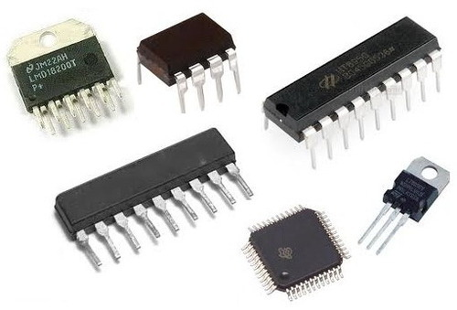
Make it Smart
ICs
“Integrated Circuits”
Notes:
Often a physical connection is made

Slide 43
Questions?

Slide 44
Circuit Diagrams & Symbols

Slide 45
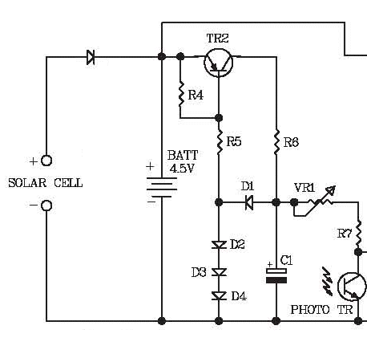
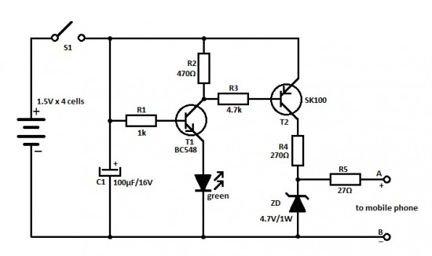
Notes:
Transistors
Resistors - zigzag or rectangle. Sometimes show value.
Solar cell or batteries (2).
Switch, diode
Capacitors

Slide 46
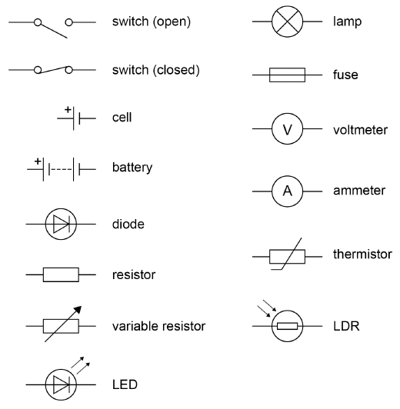
Circuit Symbols

Slide 47
Single Board Computers & Microcontrollers

Slide 48
Single Board Computers
Raspberry Pi
BeagleBone Black
Notes:
Often a physical connection is made

Slide 49
Microcontrollers
Notes:
Often a physical connection is made

Slide 50
Questions?

Slide 51
Try it out!
Use the breadboards, components, battery packs.

Slide 52
Make the circuit using a breadboard
3V Battery pack Tac switch
Red LED 47 ohm resistor

Slide 53
Packing list:
Alligator clip leads
Light bulb sockets & bulbs
3V battery pack
6V battery pack
Breadboards
LEDs
Jumper wires
Resistors

