Slide 1
Cloud + Open Source + Microsoft = Azure
Jennifer Marsman
Principal Developer Evangelist, Microsoft
http://blogs.msdn.com/jennifer
Twitter: @JenniferMarsman
Notes:
Microsoft's support for open source has grown significantly in the last year. In this session, we'll discuss some Microsoft's commitment to OSS and
Microsoft and open source? Yes! Microsoft Azure is a cloud computing platform with support for Linux virtual machines, node.js, PHP, Python, Android, iOS, Hadoop, Chef, Puppet, and more. In this session, we will demonstrate some of Azure's power (including its machine learning capabilities); you will walk away with the resources to get started in the cloud.
Title: Cloud + Open Source + Microsoft = Azure
Microsoft does open source? Yes! Microsoft Azure is a cloud computing platform with support for Linux virtual machines, node.js, PHP, Python, Android, iOS, Hadoop, Chef, Puppet, and more. In this session, we will demonstrate some of Azure's power, including its machine learning capabilities. You will walk away with the resources to get started in the cloud.

Slide 2

Open Source at Microsoft?

Slide 3

Isn’t that a sign of the apocalypse?

Slide 4
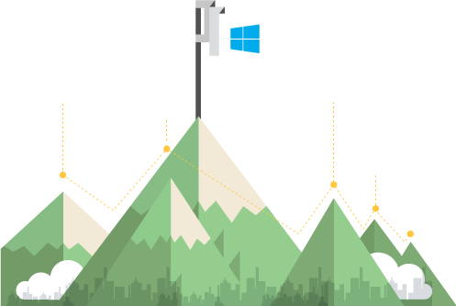


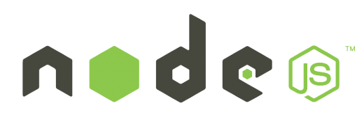




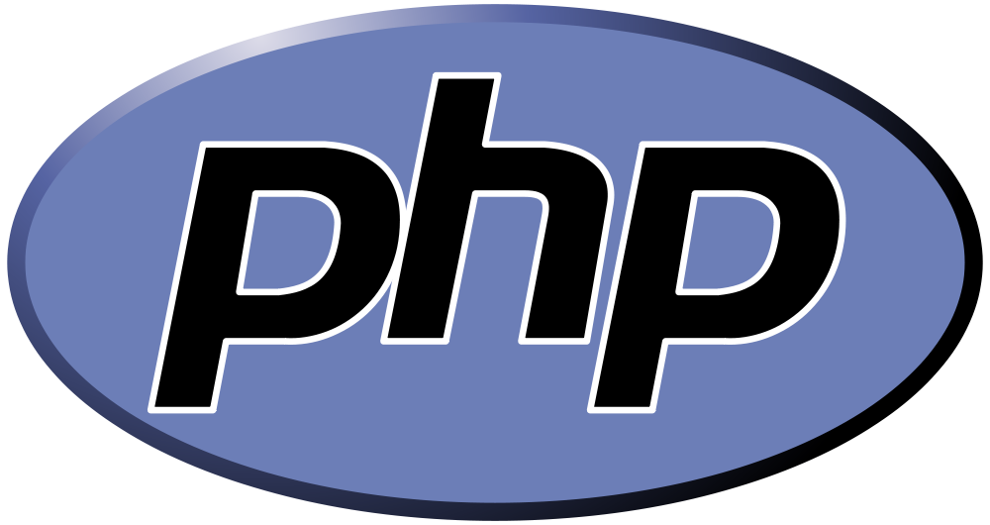
Our commitment to openness and collaboration is ingrained in our approach to
doing business alongside industry partners around
the world
Openness

Slide 5
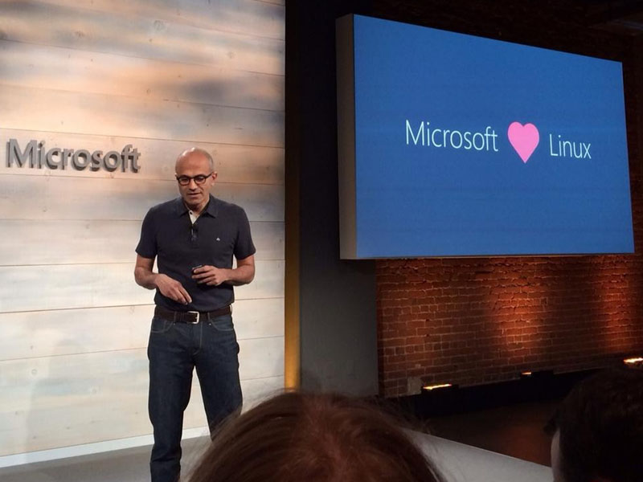
Microsoft Azure is an Open Cloud
“If you look at Azure, you can be on the Mac, use Node to build a first-class Azure app, you can be in Python, you can be in PHP...Obviously, we have Linux in terms of a guest operating system. This all adds to the flexibility and richness of the platform.”

Slide 6




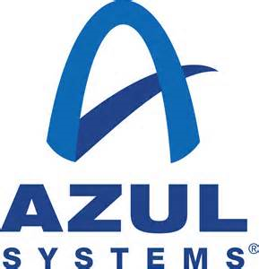
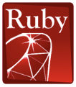




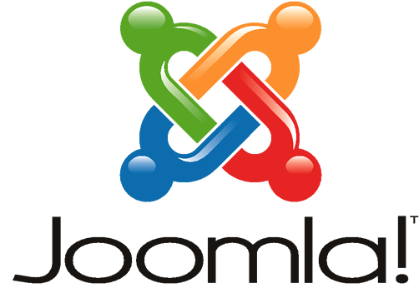
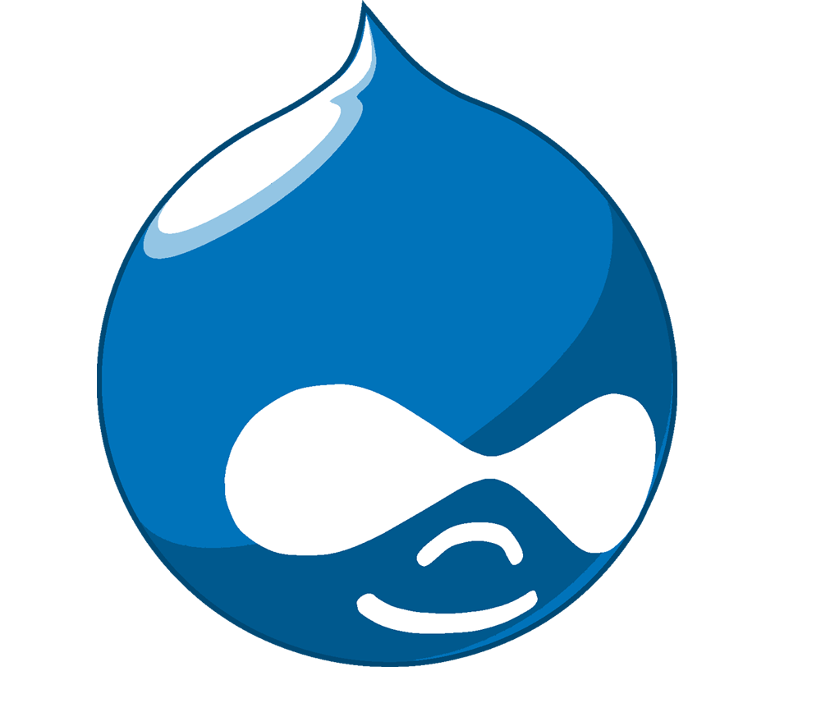
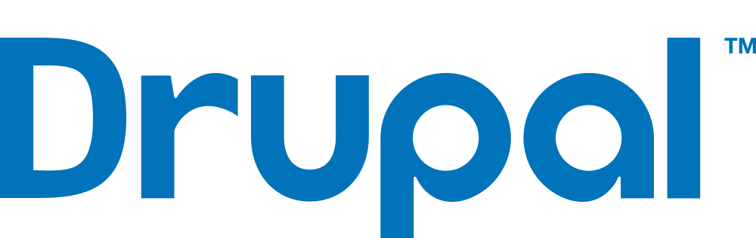

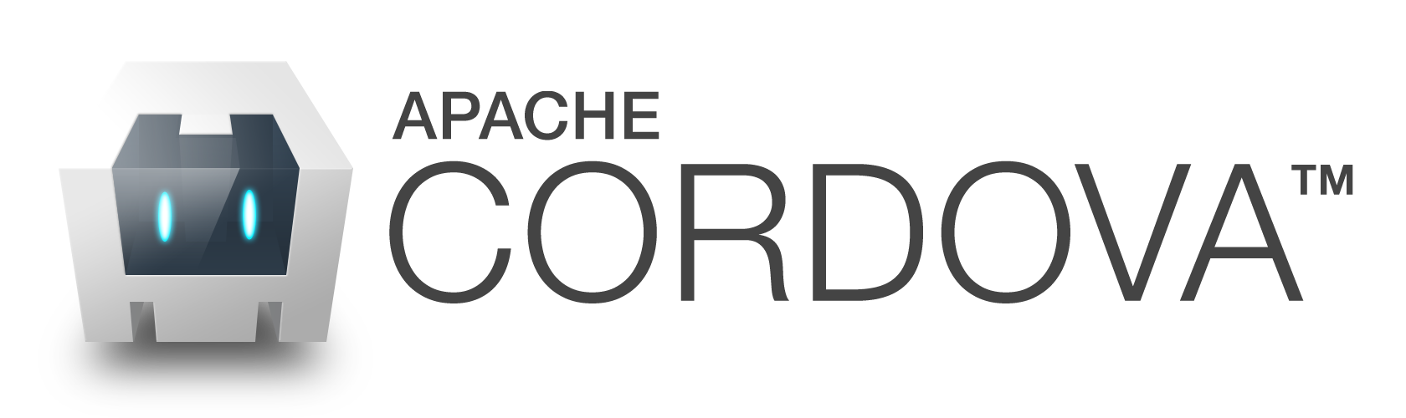


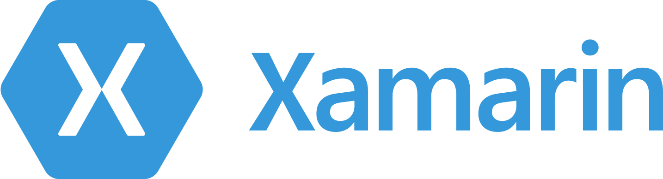








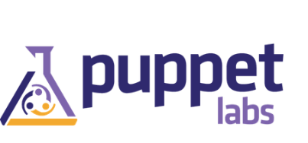
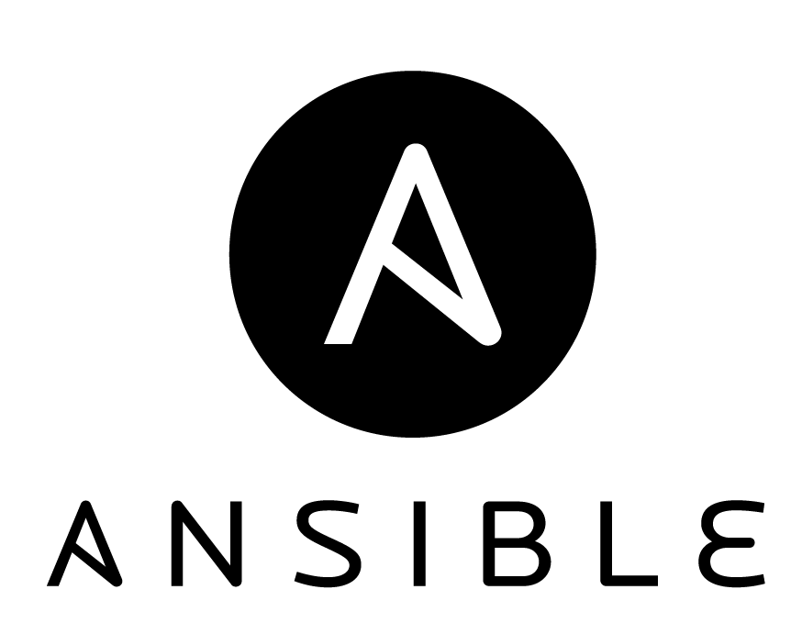
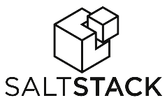
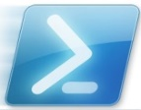


Microsoft Azure is an Open Cloud
We’ve delivered an open, broad, and flexible cloud across the stack
Microsoft integrated
Ecosystem supported
Languages,
Dev Tools, &
App Containers
Bring
your own
CMS
& Apps
Dozens of .NET & PHP CMS and Web applications
Devices
Via HTML/JS, cross-platform and native
DocDB
DataStax
Databases
libcloud
jclouds
Management
Operating
systems
Ubuntu, SUSE, OpenSUSE,
OpenLogic CentOS-based
Oracle Linux, CoreOS
Bring
your own
Notes:
We are one of the top 10 contributors to Linux and Hadoop
RedHat support: we would love to have it, but they need to certify our environment.

Slide 7
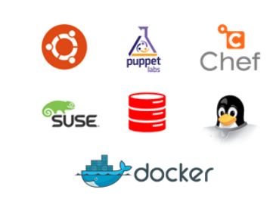
Microsoft Azure Virtual Machines
Infrastructure as a Service introduces new functionality that allows full control and management of both Windows and Linux virtual machines along with an extensive virtual networking offering.
Open, with Options
Deploy a full range of open and community-driven OS and software solutions on Azure.
Choice of a full range of Linux distributions like Ubuntu and SUSE, openSUSE, and CentOS
Community-driven solutions like Chef, Puppet, and Docker, along with other products like Oracle Database and Oracle WebLogic Server.
Notes:
Just released massive support for docker

Slide 8
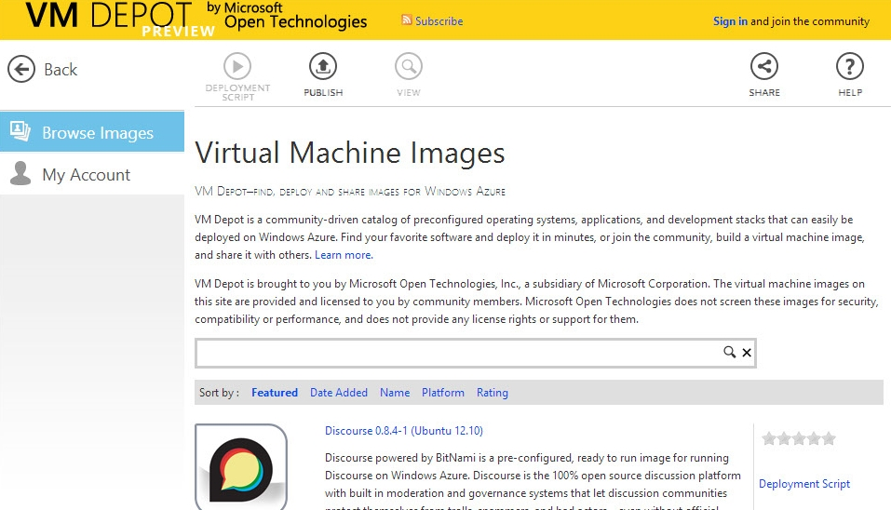
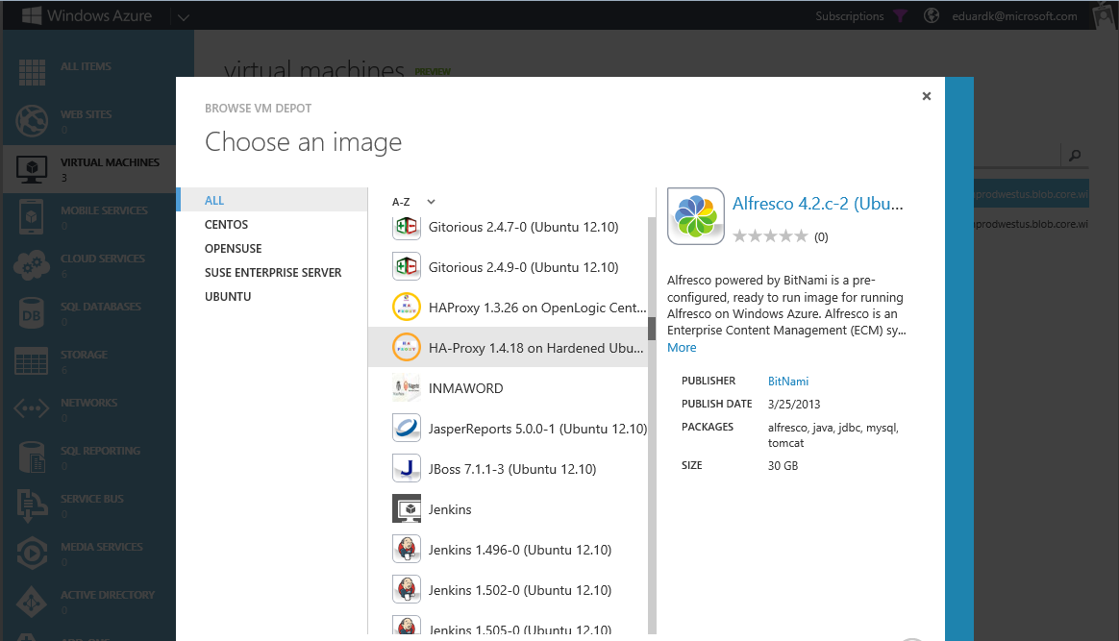
VMDepot: Microsoft Azure + Open Source Software
Growing gallery of open source Linux images
Licensed & supported by the community
Integrated with Microsoft Azure Management Portal for easy deployment

Slide 9
Microsoft Azure + Hadoop
HDInsight is our 100% Apache Hadoop-based service in the cloud
Scale elastically on demand
Crunch all data: structured,
semi-structured, unstructured
Develop in language of choice
Visualize Hadoop data in Excel
Connect on-premises Hadoop clusters
with the cloud
Includes NoSQL transactional capabilities

Slide 10
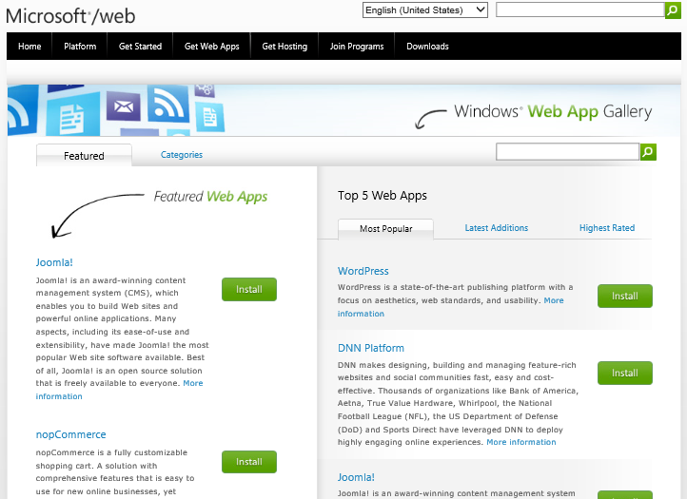
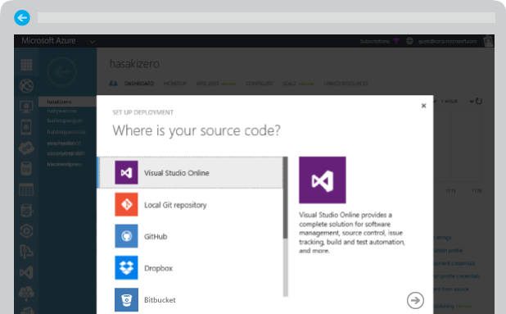
Microsoft Azure Web Sites
Azure Web Sites is a fully managed Platform-as-a-Service (PaaS) that enables you to build, deploy and scale enterprise-grade web apps in seconds.
Use ASP.NET, Java, PHP, Node.js, or Python
Run popular web apps and CMS solutions including WordPress, Drupal, Joomla, Umbraco, and DotNetNuke
Support for Microsoft SQL, MySQL, MongoDB, Document DB, Redis, & Azure Table Storage
Continuous deployment workflows with VSO, GitHub, TeamCity, Hudson, or BitBucket

Slide 11
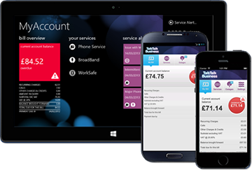
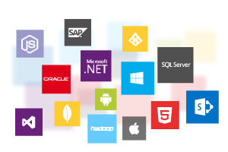
Microsoft Azure Mobile Services
Mobile Services provides a scalable and secure backend that can be used to power apps on any platform–iOS, Android, Windows, or Mac
Build scalable iOS, Android, and Windows apps
Easily authenticate your users with Active Directory
Securely connect to on-premises resources like SAP, Oracle, and SQL Server
Leverage cross-platform frameworks like Xamarin and PhoneGap to build enterprise-grade apps for your employees
Notes:
Built in node
Backend can be written in node or C#
Notification platform (can tag people with metadata and sub-address your group that way – all Silver status people within 10 miles of Southfield can get this coupon)

Slide 12


Microsoft + Open Source Momentum
Microsoft Azure
CodePlex membership has more than tripled
downloads
Microsoft
WebMatrix
20%
Linux
1,100,000+
300,000
>1,000 Linux VMs to choose from
2010
2014
SUSE-Microsoft Alliance customers
Significant code and engineering hours dedicated to Hadoop core, Hive and Tez
>1,000
>1M
Notes:
WebMatrix – can use to edit php and others, optimized for open source, can integrate with git
CodePlex – we have been walking down this road for over 5 years, slowly turning the battleship

Slide 13












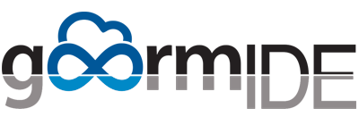

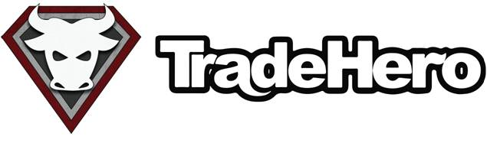






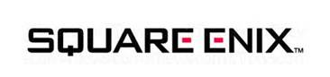
Open Source on Azure Customers

Slide 14


What Our Customers Say: British & Irish Lions
”We thought hosting Linux on [Microsoft] Azure would be tough. We were wrong. Everything just worked. And the console and configuration flexibility was an advantage over what we see from other cloud providers.”
Macdara Butler
Commercial Director - Elite Edge
Solution
The team created a mobile app that gave millions of fans around the world a front row seat. Hosted on Microsoft Azure, the app featured behind-the-scenes content, interactive competitions, near real-time videos, and other innovative features, delivered to Windows, Apple, and Android devices.
Benefits
Non-professionals easily uploaded near real-time video
Supported 12,000 page requests per second with 10 instances
Reduced development time/cost and hosting expense by 80%

Slide 15
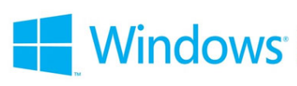

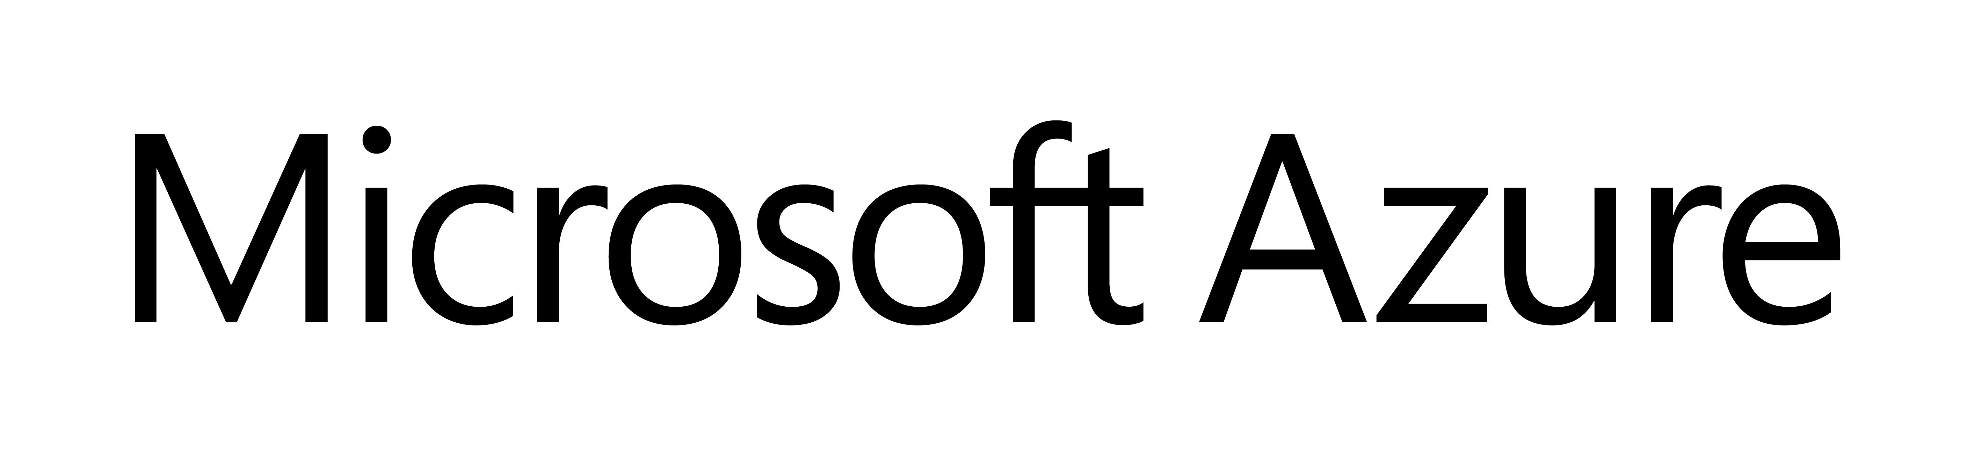

BizSpark – A Global Program for Startups www.microsoft.com/bizspark
Access to featured Microsoft Technologies:
Microsoft BizSpark is a global program that provides free software, support and visibility to help startups succeed. Over 100K startups from 165+ countries have joined BizSpark. The three year program is free of charge and gives startups:
Software
Support
Visibility
Eligibility
Three year access to current,
full-featured software
development tools
$150 of monthly Microsoft Azure benefits to quickly build, deploy and manage web applications
Free access to Windows and Windows Phone Developer Accounts
Professional technical
and product support
Unique and valuable offers from the BizSpark Network Partners to help run your business
Four free MSDN Support Incidents
Profile, Offers and Events
A connection to the BizSpark ecosystem, giving startups access to investors, advisors
and mentors
Opportunities to achieve marketing visibility
To qualify, startups must be:
Developing Software
Privately held and making less than
US $1M in revenue per year
Less than 5 years old
100+ Countries
50K Startups

Slide 16
Questions?

Slide 17
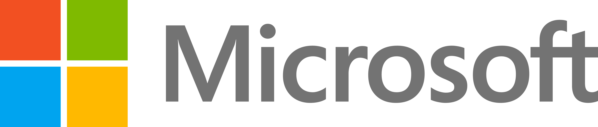
© 2014 Microsoft Corporation. All rights reserved. Microsoft, Windows, Windows Vista and other product names are or may be registered trademarks and/or trademarks in the U.S. and/or other countries.
The information herein is for informational purposes only and represents the current view of Microsoft Corporation as of the date of this presentation. Because Microsoft must respond to changing market conditions, it should not be interpreted to be a commitment on the part of Microsoft, and Microsoft cannot guarantee the accuracy of any information provided after the date of this presentation. MICROSOFT MAKES NO WARRANTIES, EXPRESS, IMPLIED OR STATUTORY, AS TO THE INFORMATION IN THIS PRESENTATION.

