Slide 1
Burlesque 101
With Tommy Gun and Darryn Storm

Slide 2
What the heck are we going to cover?
Who the heck are we?
What even is burlesque?
Including different genres
A brief history of burlesque
Staple burly moves

Slide 3
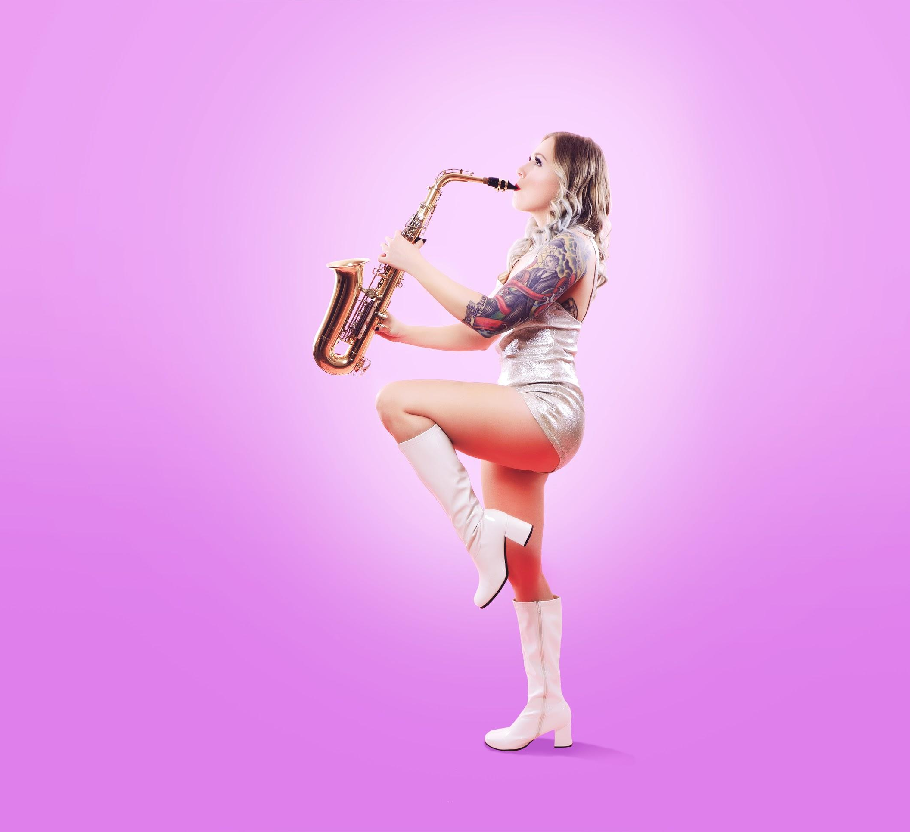
Tommy Gun
Performed in Rocky Horror Picture Show shadow casts in Flint, MI off and on from 2006 - 2015
Discovered burlesque in 2011-ish, began pursuing it in 2015
Started performing burlesque & aerial silks in 2017
Train(ed) at
Aerial Dragonfly in Ferndale, MI
Detroit School of Burlesque
Website: https://www.tommygunburlesque.com/
Facebook: https://www.facebook.com/tommygunburlesque/
Instagram: @mstommygun

Slide 4
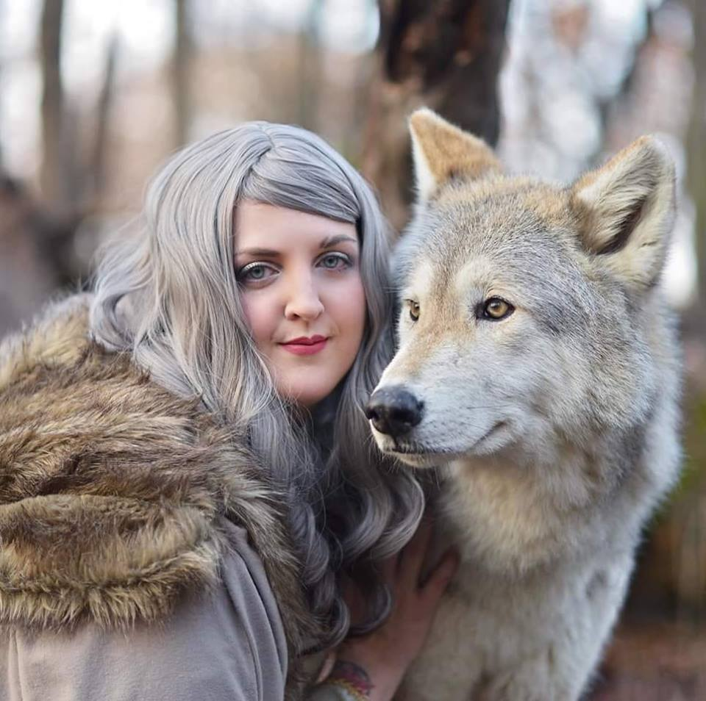
Darryn Storm
Darryn Storm blew into the burlesque scene with enough force to send you running for cover - or tickets to the next show. With years of training in dance and a penchant for physicality, there’s no doubt she has the moves to keep you captivated.
Facebook: https://www.facebook.com/DarrynStormBurlesque/
Instagram: @darryn_storm

Slide 5
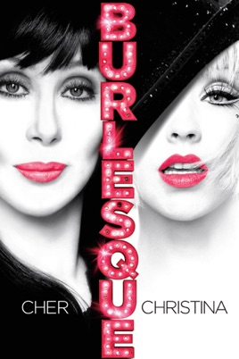
What is burlesque?
It’s not like the Cher movie!
Today, “burlesque” is mostly synonymous with striptease.
This can take a lot of different forms! Think of it like performance art...but often sillier and sparklier.
Burlesque shows may contain almost entirely striptease acts, but they regularly also feature variety acts such as comedians, singers, acrobats, sideshow acts, etc.

Slide 6
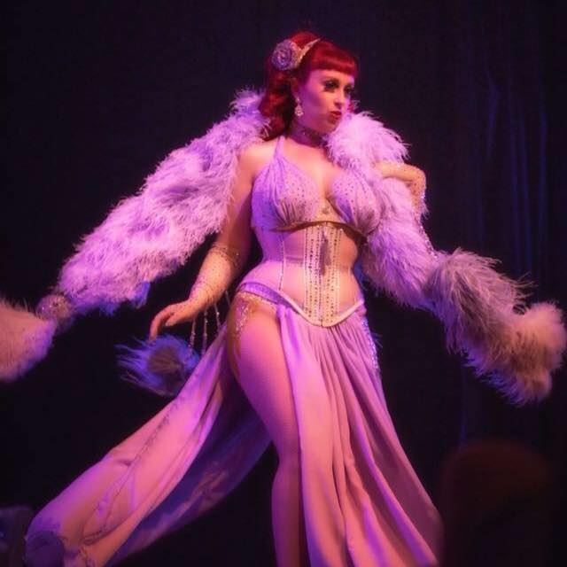
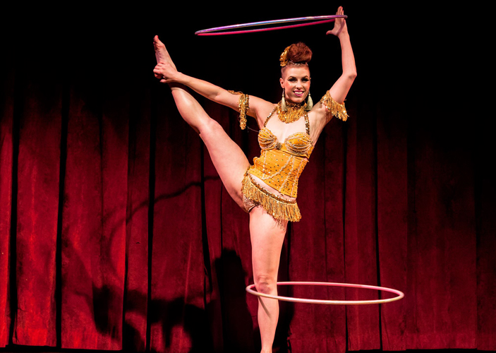
Burlesque Genres
Classic
Classic, often jazzy music
Luxurious, glamorous costumes and props: gowns, gloves, corsets, feather fans, boas
Vintage styling for hair and makeup
Neo-burlesque (new burlesque)
Usually modern music, could be any genre
Encompasses many different styles of dance
Wide range of costumes and props

Slide 7
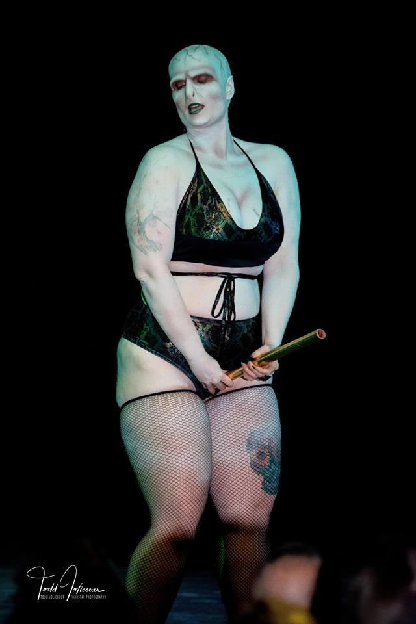
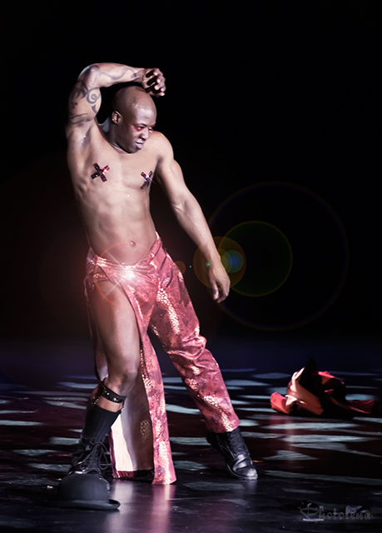
Burlesque Genres cont.
Nerdlesque
Intersection between cosplay and burlesque (often interpretations of a character rather than accurate costuming)
Theme shows are currently becoming increasingly common
Boylesque
Burlesque is historically a women’s art form, male identifying performers are typically referred to “boylesque” performers although their burly style may fit into a number of other genres.

Slide 8
Mainstream Burlesque vs. “Real life”
For the vast majority of performers, burlesque is a hobby and not a career.
Unfortunately the most popular, well-known performers that have made a career out of burlesque (like Dita von Teese) are primarily thin white women.
This is not an accurate representation of the burlesque community however! Local burlesque shows tend to be extremely body positive and showcase a wide variety of body types.
POC and differently abled people to still tend to be under represented, but this is changing!

Slide 9
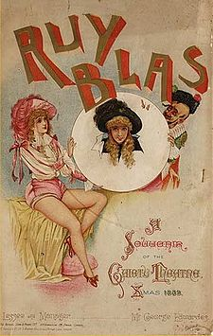
So how did burlesque become a thing anyway?
The word “burlesque” comes from Italian, and essentially means “mockery”
The term first appeared in the 16th century, as the name of an Italian opera
In the 17th century the term spread to France, Spain, and England as a literary genre comprised of satire and parody
Ex. Some of Shakespeare's work, including A Midsummer Night’s Dream is considered burlesque, in that it is intentionally ridiculous and mocks certain types of people
In the 1800’s, initially in London but then also in New York, travesties (now also known as Victorian burlesque) began popping up.
These were largely rique parodies of well known operas and plays
Burlesque shows were more accessible than say the opera, and were basically making fun of high society and the bourgeoisie

Slide 10
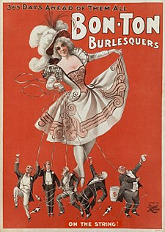
American Burlesque
Victorian burlesque fell out of fashion in England in the 1890s, but continued to be popular in the US
Burlesque shows began to take on a structure similar to that of minstrel shows:
1st act: comedy sketches, parody songs
2nd act: male variety acts such as magicians and acrobats
3rd act: chorus numbers, or victorian style parody of a play or current event
Conclusion: exotic dancer or boxing match
Emphasis on exotic dancing and female nudity increased in the early 1900s, and burlesque shows began to become more popular than less politically charged vaudeville shows (which were similar variety shows, the subject matter just tended to be lighter).

Slide 11
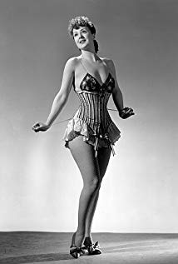
1930’s-Today
By the late 1930’s a typical burlesque show consisted of 6 or so ecdysiasts, a comedian or two, and an emcee. This is similar to the format of many shows today!
However with prohibition and then access to films containing nudity, burlesque fell out of fashion by the 1970’s.
In the 1990’s burlesque began to see a revival (the advent of neo-burlesque) and has been steadily gaining in mainstream popularity over the last couple decades as it encompases more styles and becomes more accessible.

Slide 12
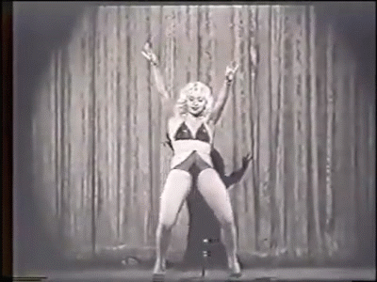
Staple burlesque moves!
Glove peels
Feather boas
Bumps and grinds
Shimmies

