Slide 1
BUILD (or boost) YOUR OWN ROUTER
With Tomato, DD-WRT, or pfSense
Steven Ostrowski & Britain Woodman Penguicon 2016

Slide 2
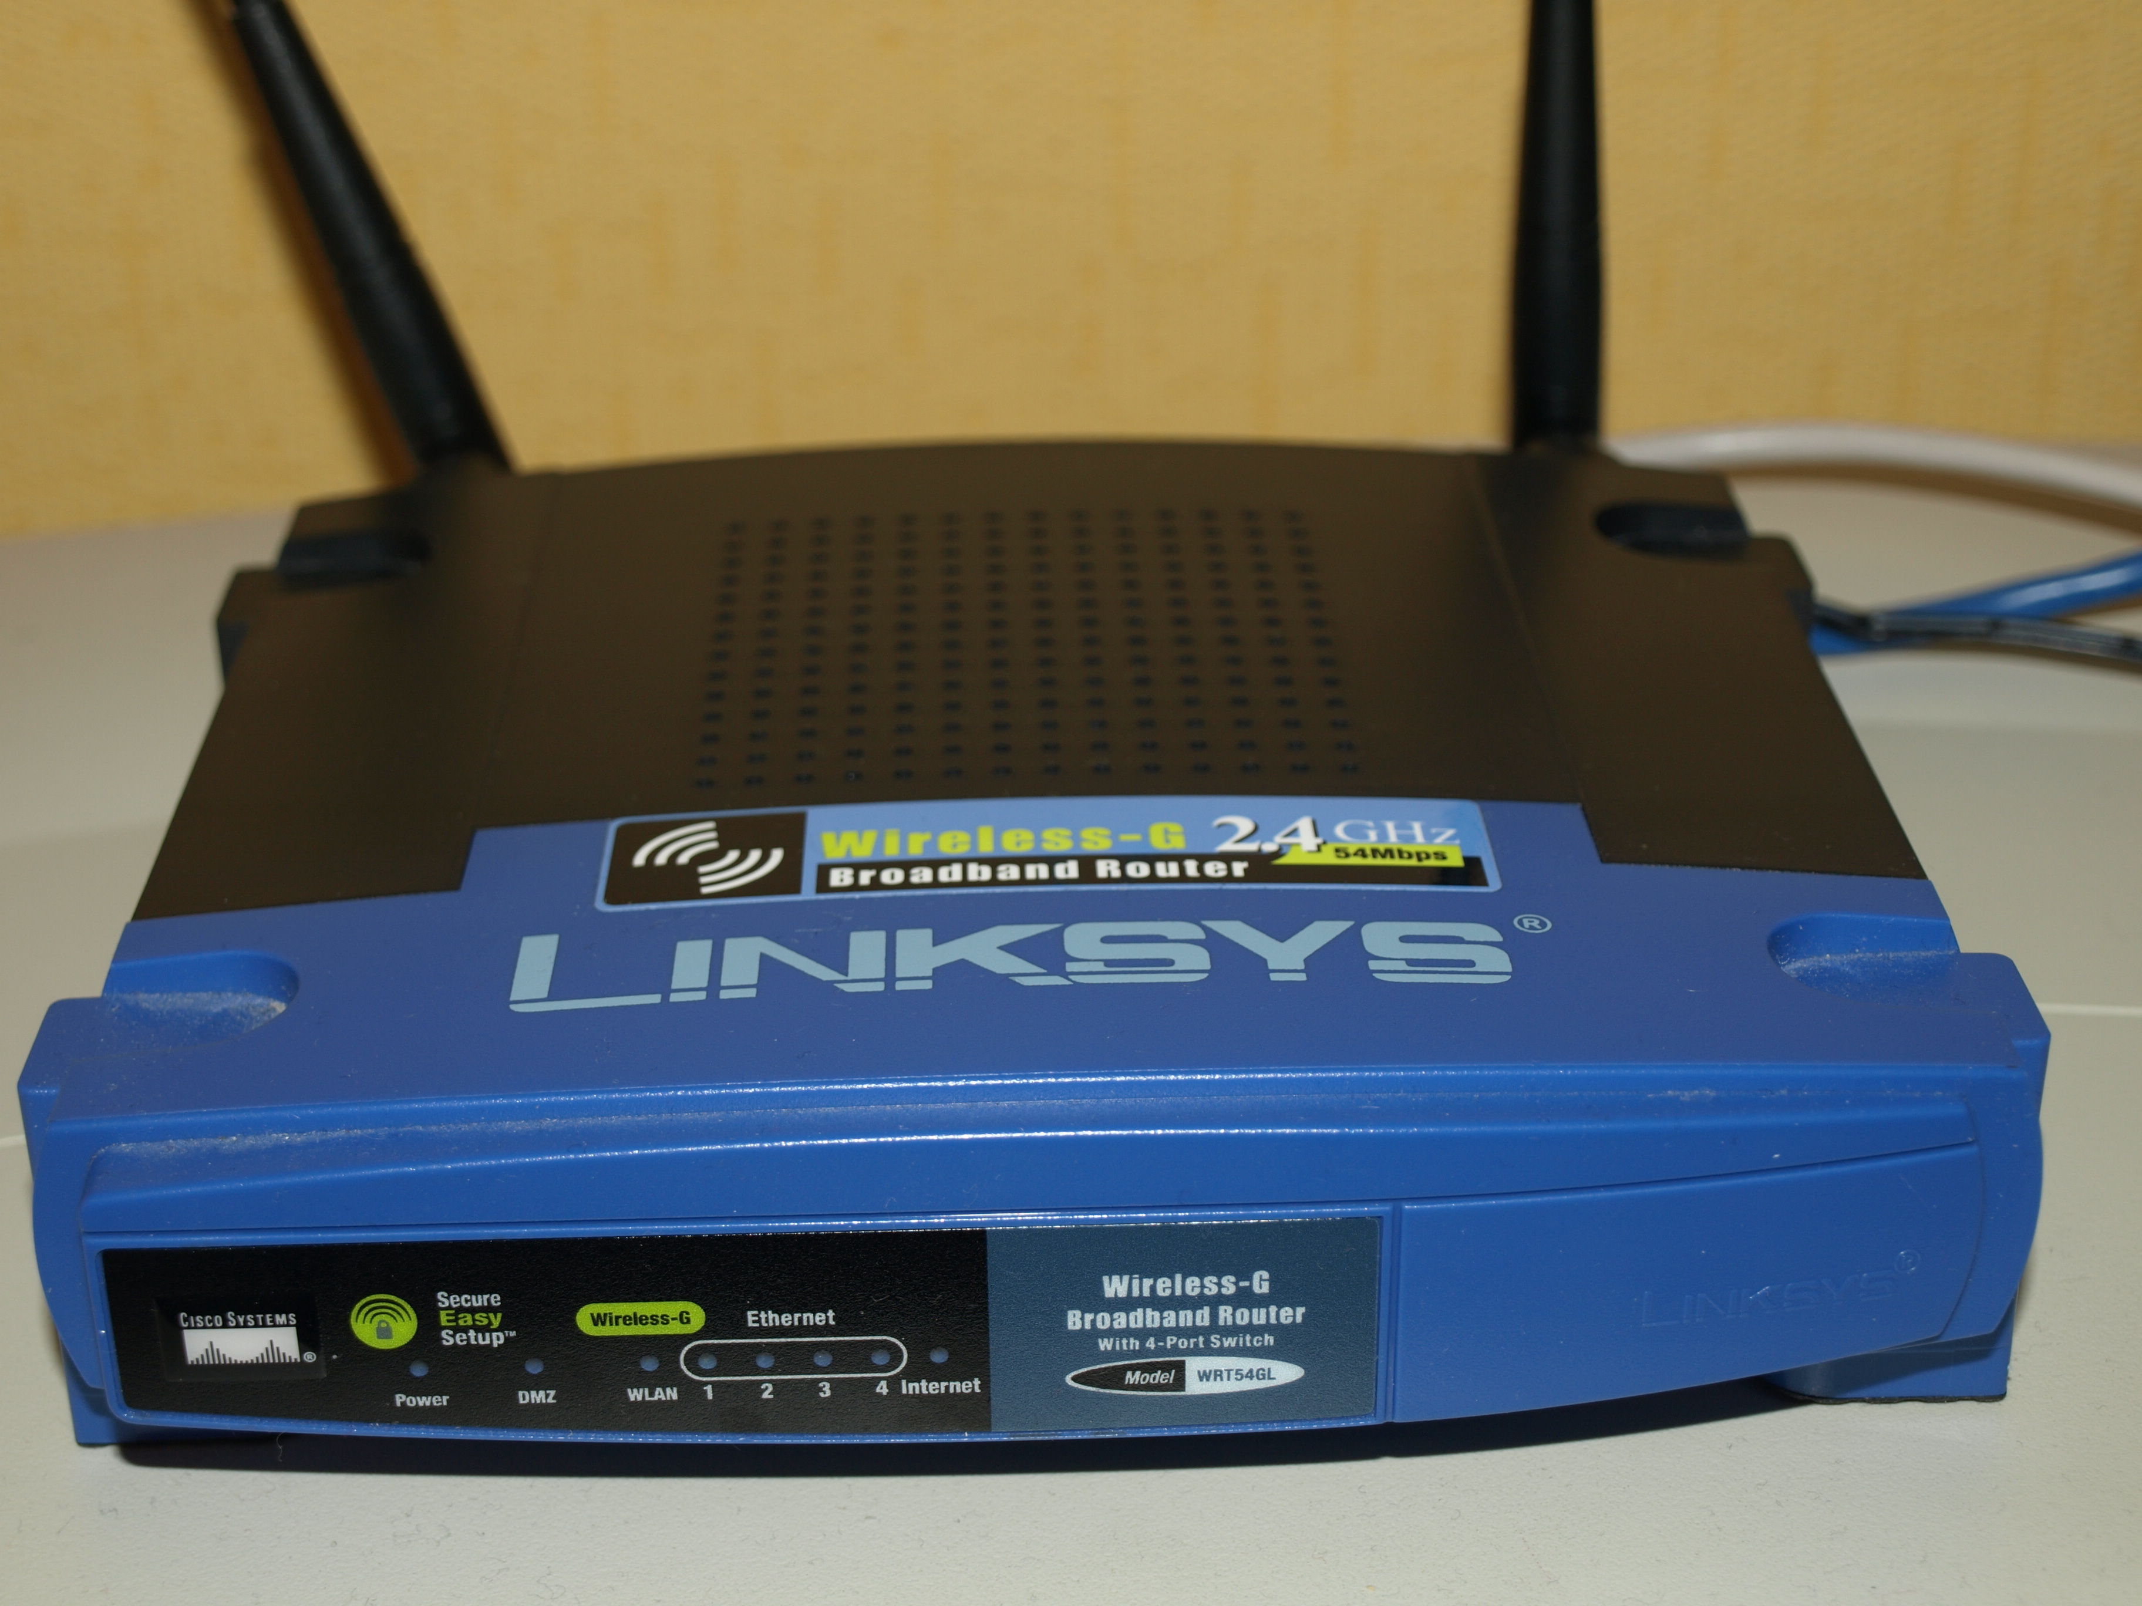
Alternative firmware
Notes:
The Linksys WRT54GL, the Linux-running variant of the popular line of Broadcom-based consumer routers
Linksys released source in July 2003 and the scene grew out of that
Sveasoft
OpenWRT
DD-WRT
Tomato

Slide 3
Picking a Compatible Router
Factors to consider
Wireless Technology (B/G/N/AC, 2.4GHz or 5 GHz, etc.)
CPU
RAM
Port connection speeds (10/100/1000)
For DD-WRT
http://www.dd-wrt.com/wiki/index.php/Supported_Devices
For Tomato:
Find a router you want and google it i.e. “Linksys e2000 Tomato”

Slide 4
Picking a Compatible Router
Manufacturer-specific Support Sites
Linksys: linksysinfo.org
Netgear: myopenrouter.com

Slide 5
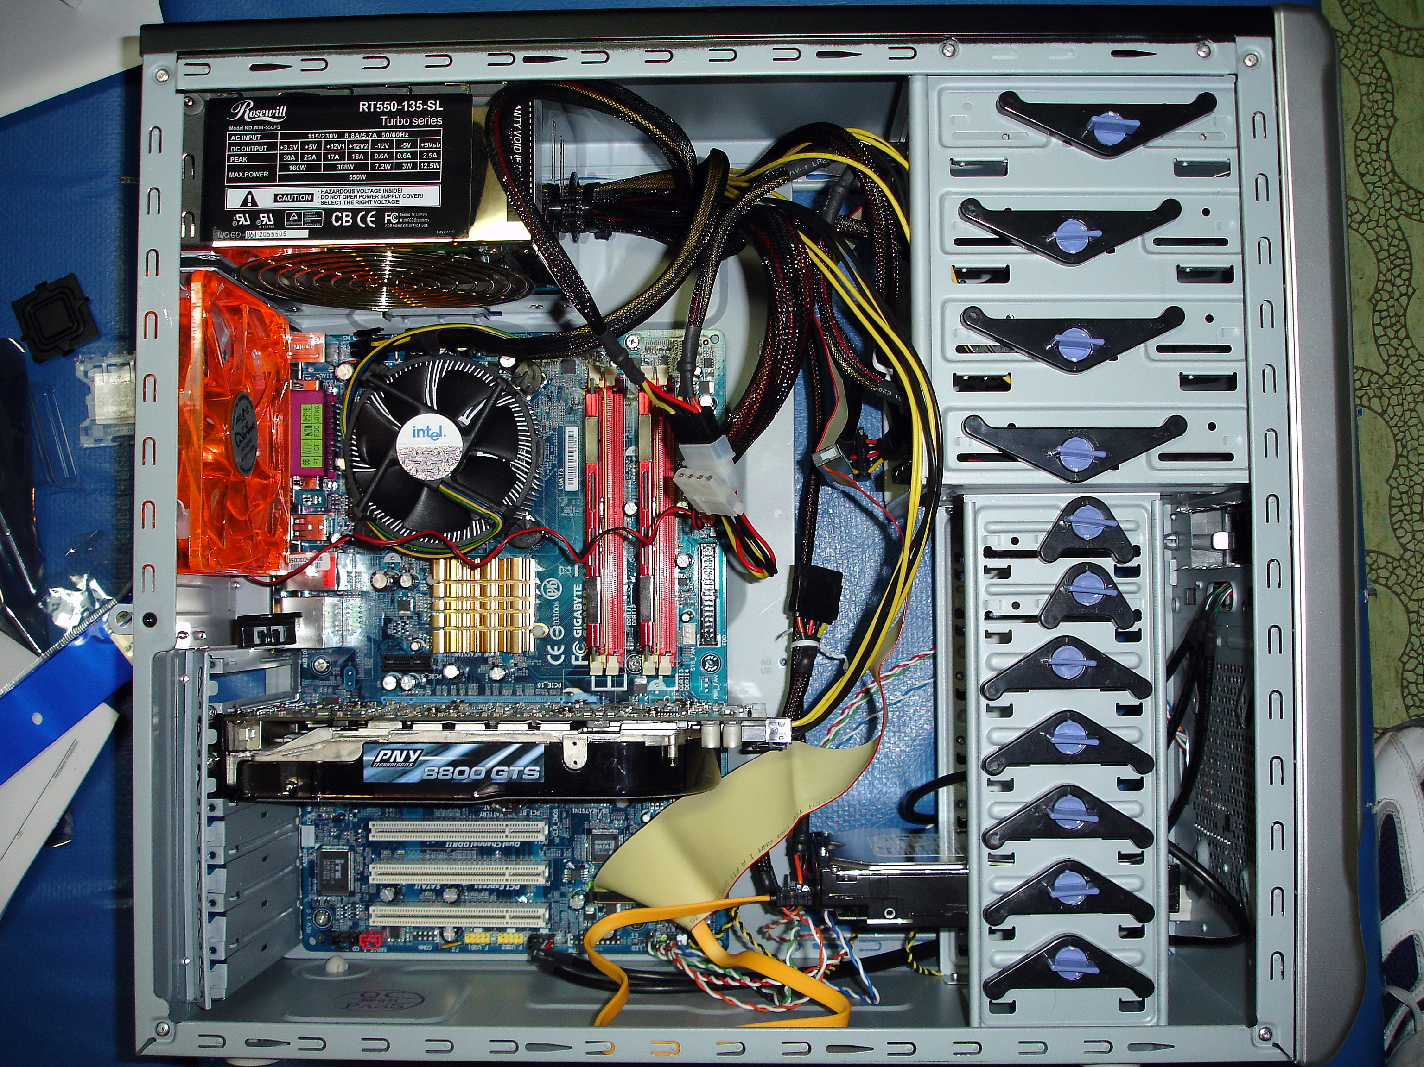
Converting Existing Hardware (aka turning an old PC into an awesome router)

Slide 6
Converting Existing Hardware (aka turning an old PC into an awesome router)
Any x86 computer can be used, many software packages exist
PfSense
Smoothwall
Recommend reading the software provider’s website for recommendations
Server / Enterprise Grade NIC’s are a good addition, both PCI and PCI-E are available
PfSense Recommends Intel NIC’s

Slide 7
Some stuff you might like
OpenVPN
Protect yourself in public
OpenDNS Family Shield
Very simple family protection, if you’re into that

