Slide 1
Beauty Basics 101:
What the hell is all this s**t?

Slide 2
Workshop Overview
Presenter Intro
Rules Rant
Full Face Review
Drugstore vs High End vs Luxury Products
Recommendations and Favorite Products
Terms Not Appearing In This Film
What else…..?

Slide 3
Presenter Intro
Anneliese Freiny
NOT a professional Makeup Artist
NOT a YouTube personality
NOT a Beauty Blogger
NOT an Instagram Model
#notsponsored
Just a regular makeup lover that enjoys geeking out with others and empowering people to find their own style and a routine that works for them.

Slide 4
Rules Rant
If you think you look good, you look good. Period.
Do it for YOU!
If you can’t say something nice, don’t say anything at all.

Slide 5
Full Face Review
Prepare Your Skin
Eyes
Foundation/Skin
Brows
Finishing Touches

Slide 6
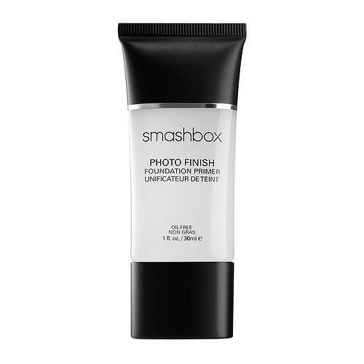
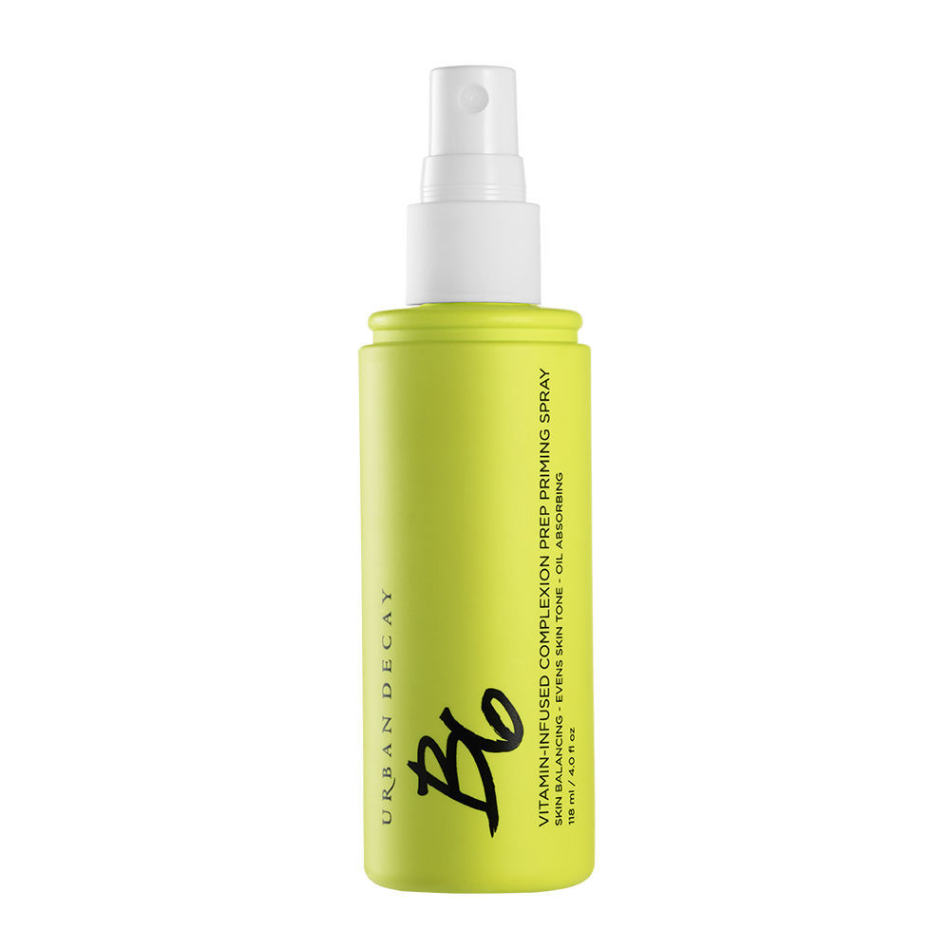
Prepare Your Skin
Cleanse
Moisturize
Prime

Slide 7
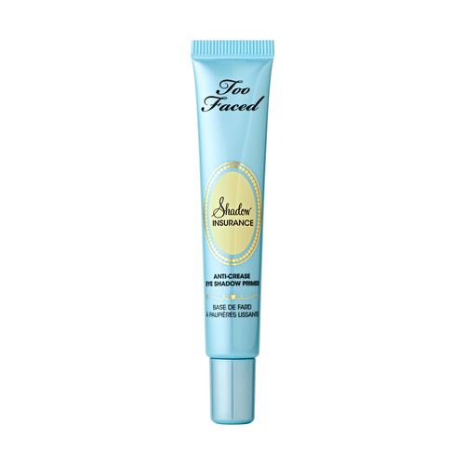
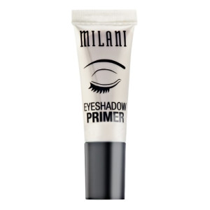
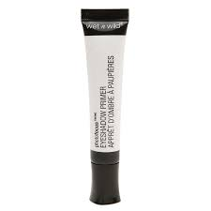
Eyes
Prime – Yes, prime your eyes!
Helps shadow stay in place.
Prevents creasing.
Increases color vibrancy.

Slide 8
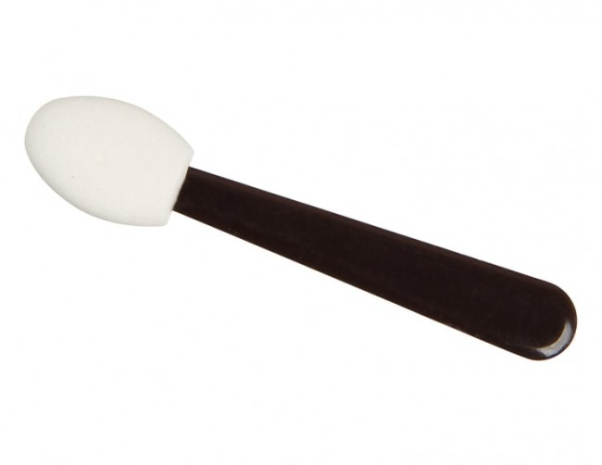
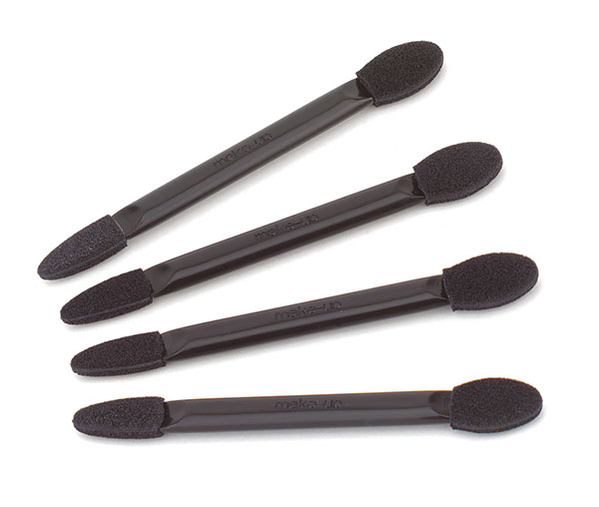
Eyes
Tools
Good ole fashioned sponge tip applicator – it rarely gets the love it deserves!
Brushes

Slide 9
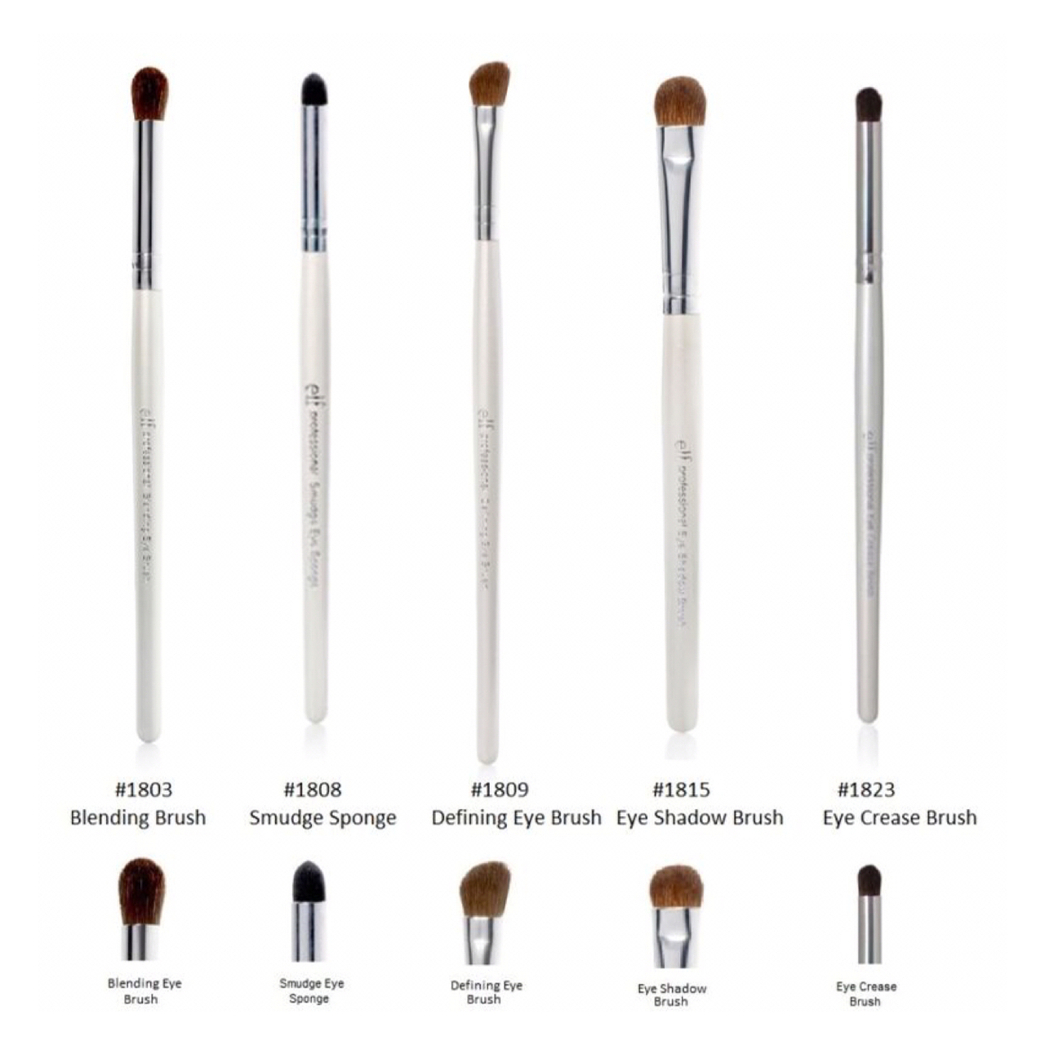
Eyes

Slide 10
Eyes
“Common” Eye Looks
One Color
Two Color Transition (I totally made this up as a name for what I do most often!)
Smokey
Halo
Cut Crease

Slide 11
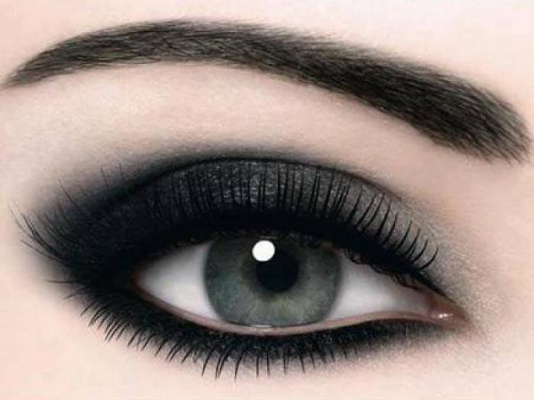
Eyes
Smokey

Slide 12
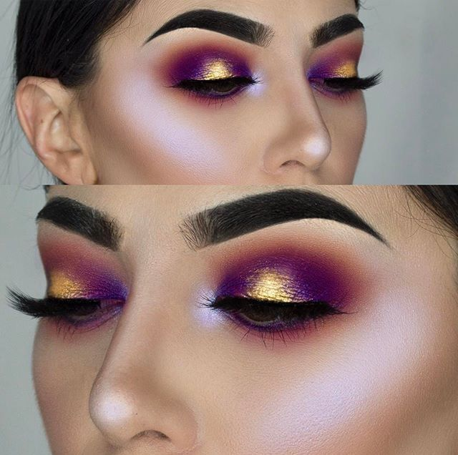
Eyes
Halo

Slide 13
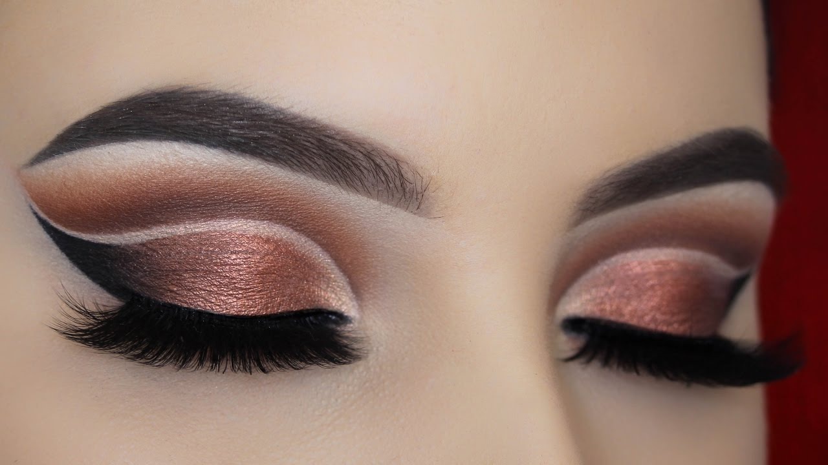
Eyes
Cut Crease

Slide 14
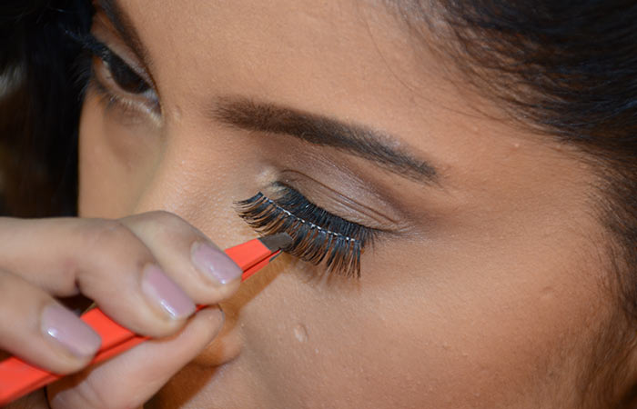
Eyes
Mascara
False Lashes – YIKES!

Slide 15
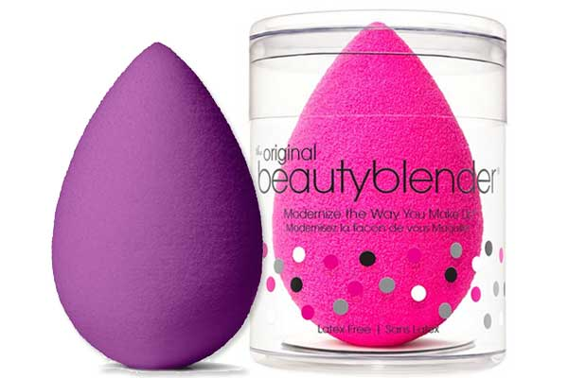
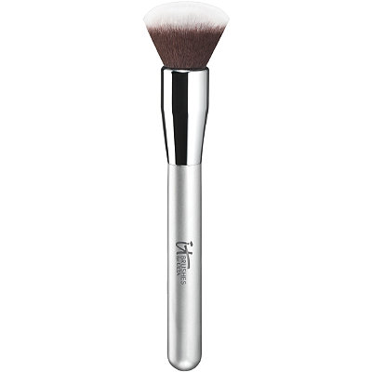
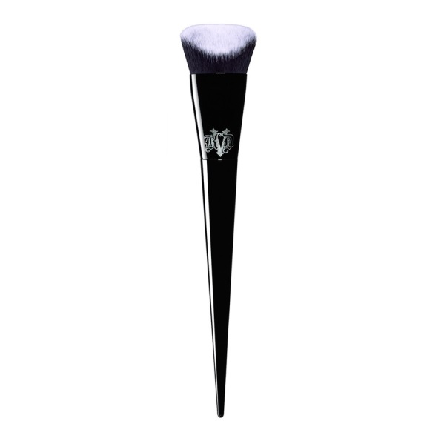
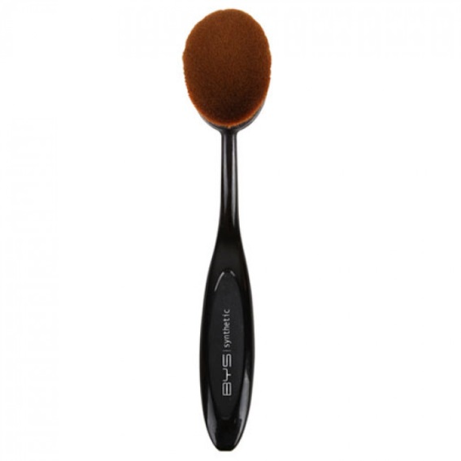
Foundation/Skin
Foundation
Brush Application
Sponge Application
Dampen that sucker!

Slide 16
Foundation/Skin
Concealer
To brighten skin or conceal imperfections
Powder
Setting and Baking(?!)

Slide 17
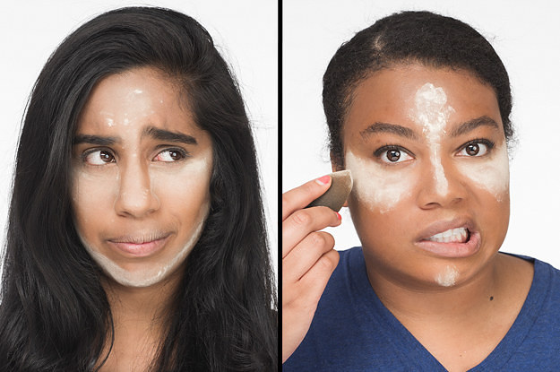
Foundation/Skin

Slide 18
Foundation/Skin
Bronzer
Blush
Contour
Highlighter

Slide 19
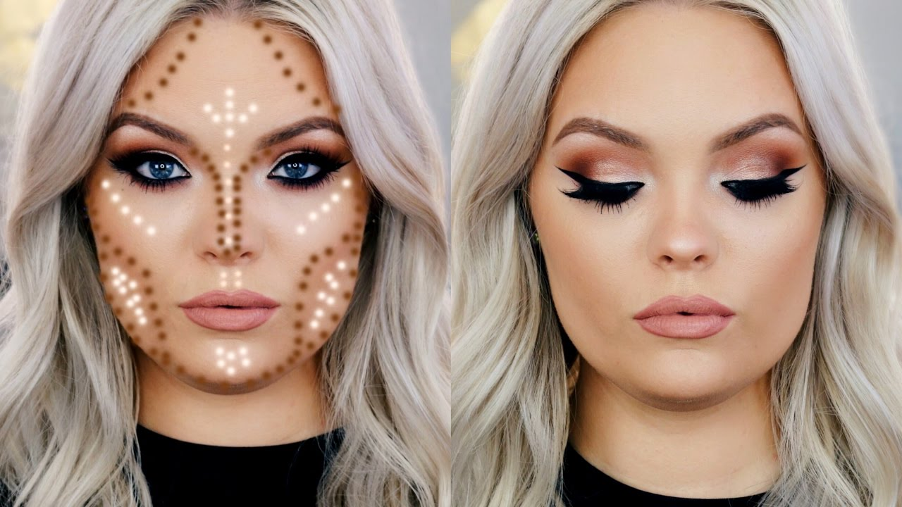
Foundation/Skin

Slide 20
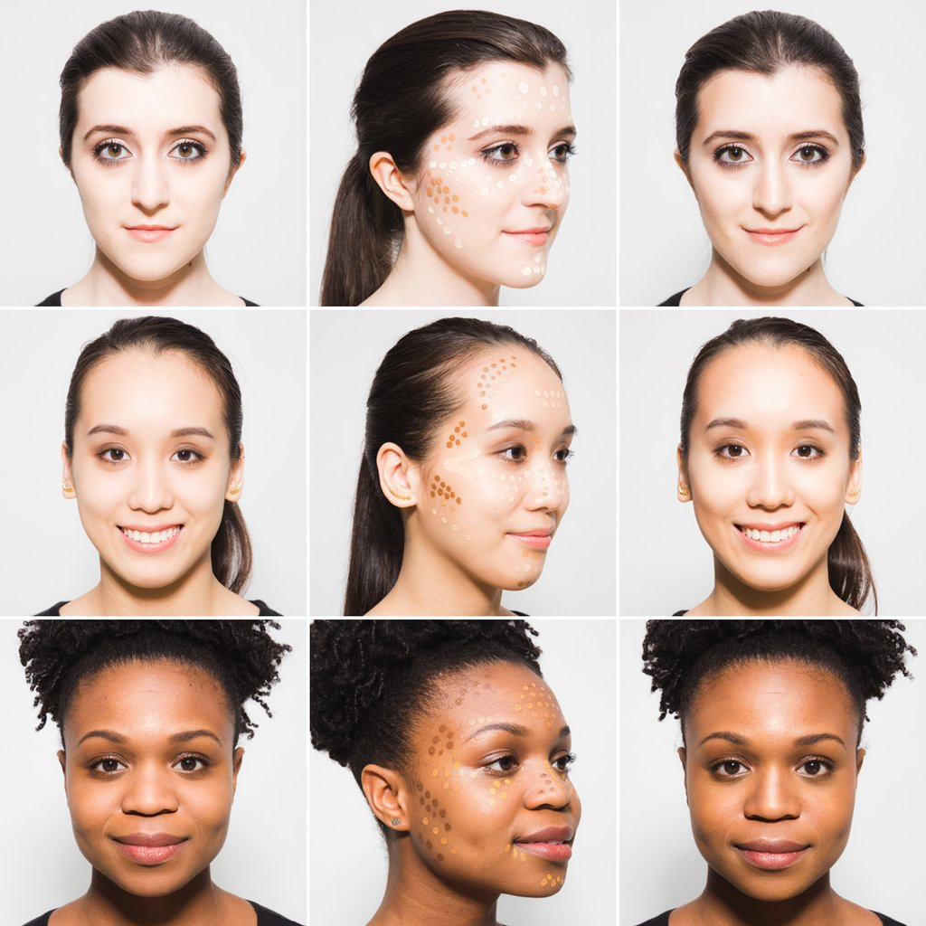
Foundation/Skin

Slide 21
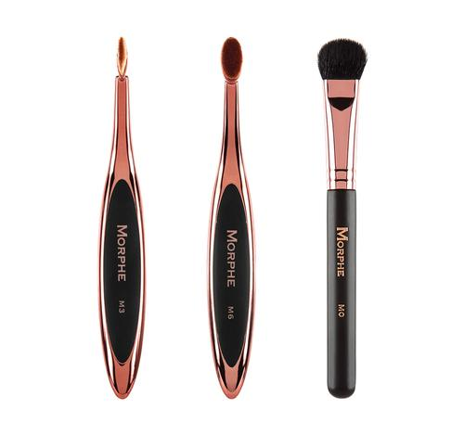
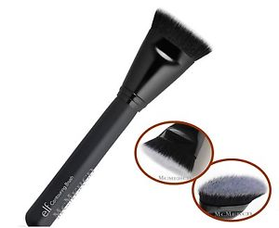
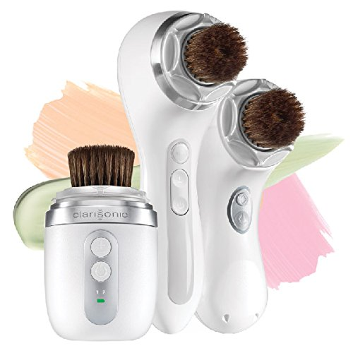
Foundation/Skin

Slide 22
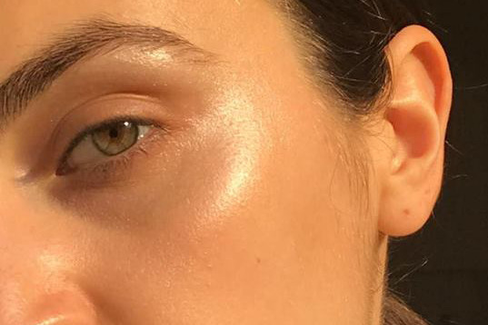
Foundation/Skin

Slide 23
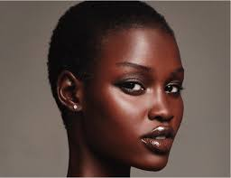
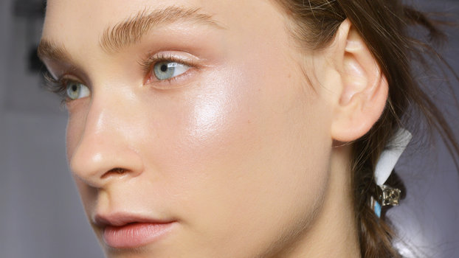
Foundation/Skin

Slide 24
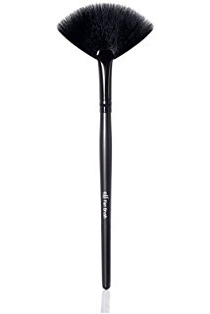
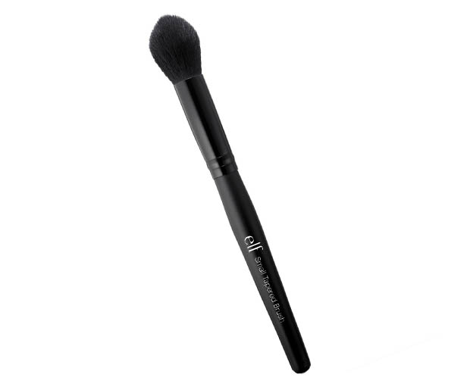
Foundation/Skin

Slide 25
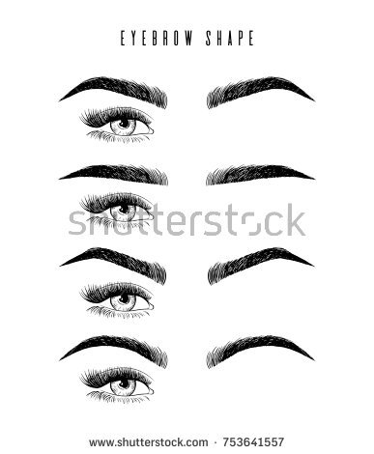
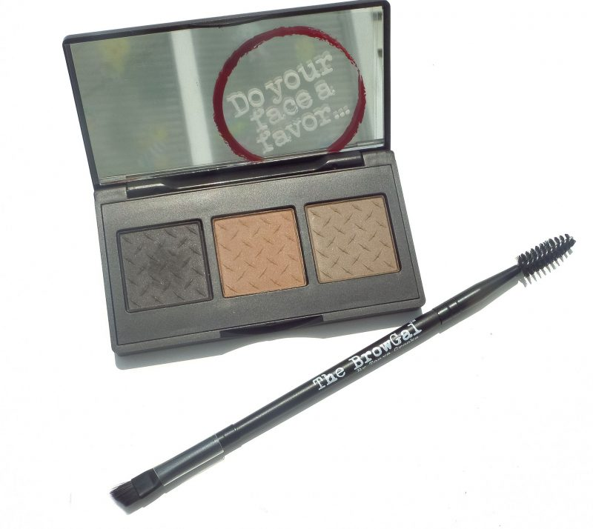
Brows
Pomade
Gel
Pencil
Powder

Slide 26
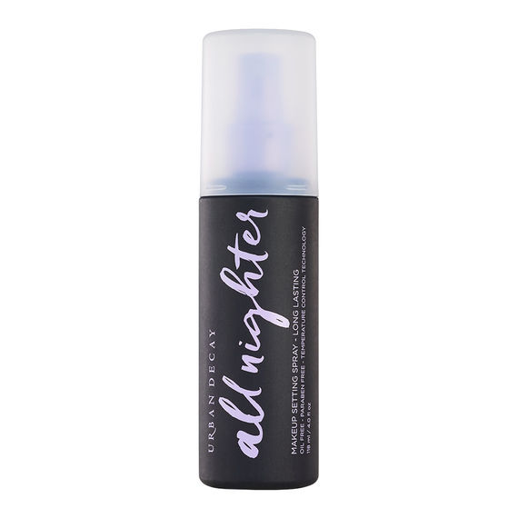
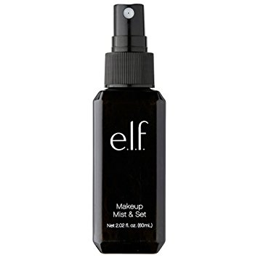
Finishing Touches
Setting Spray
Essentially hairspray for your face! Improves makeup staying power.
Matte, Dewy, Oil Control, Shimmer

Slide 27
Drugstore vs High End vs Luxury Products
Is there really a difference?
Which performs better?
Where should I splurge?
Where can I save?

Slide 28
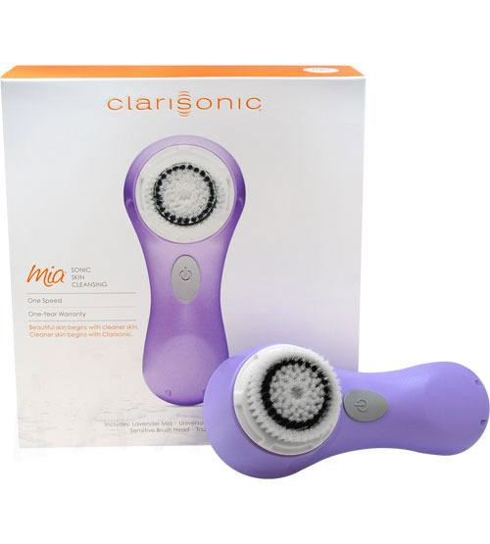
Where should I splurge?
Skin Care
Clarisonic Cleansing Tool

Slide 29
Where should I splurge?
Eye Shadow
Tends to crease less.
Lasts longer.
Higher pigmentation and better color payoff.

Slide 30
Where can I save?
Eyeshadow Primer
Blush
Mascara

Slide 31
Recommendations and Favorite Products
Return Policies – That’s right, you can often take it back!
Ebates
Eyeshadow
Lipstick
Foundation
Subscription Boxes!

Slide 32
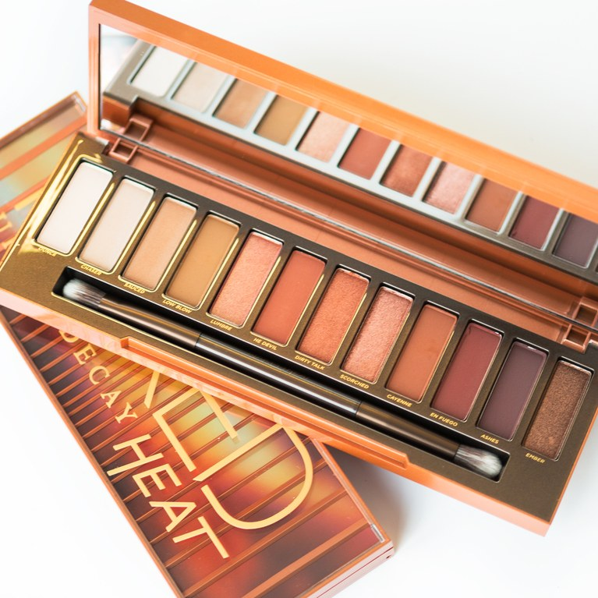
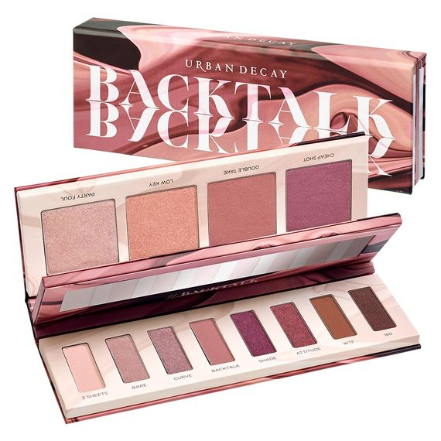
Recommendations and Favorite Products

Slide 33
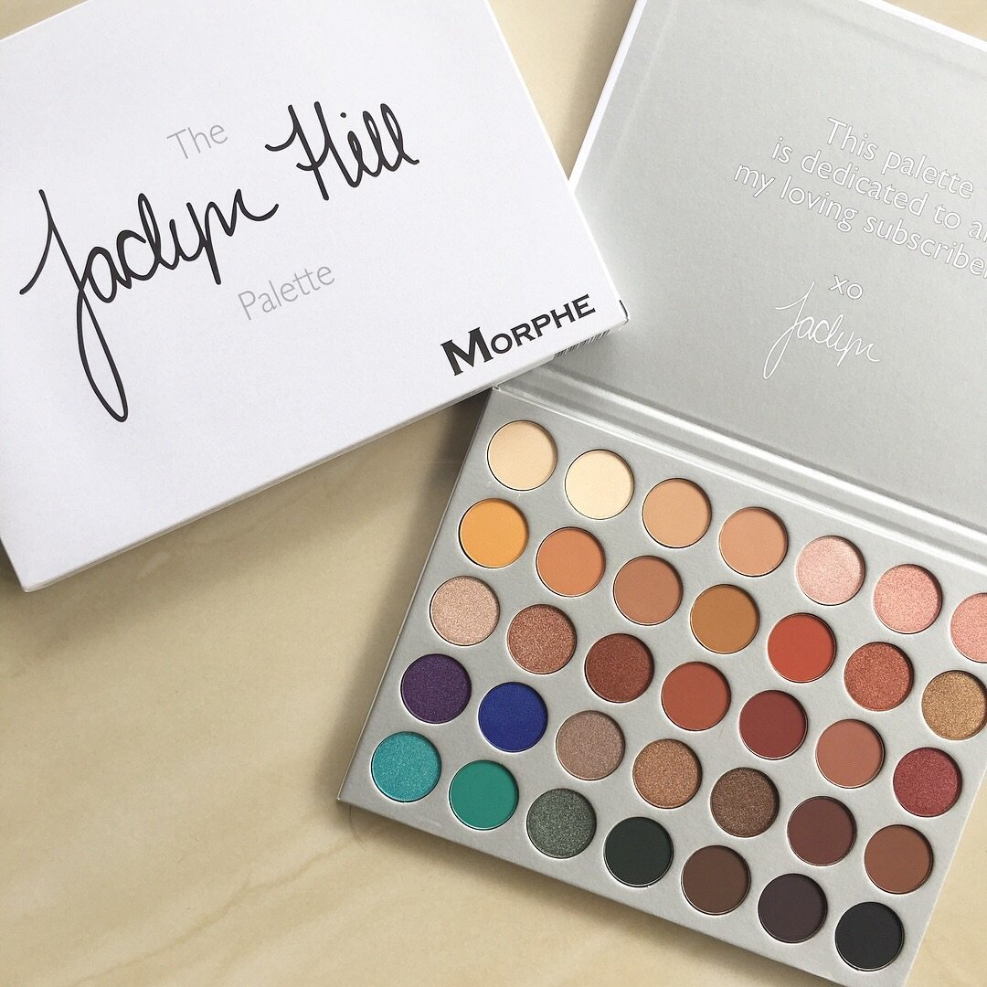
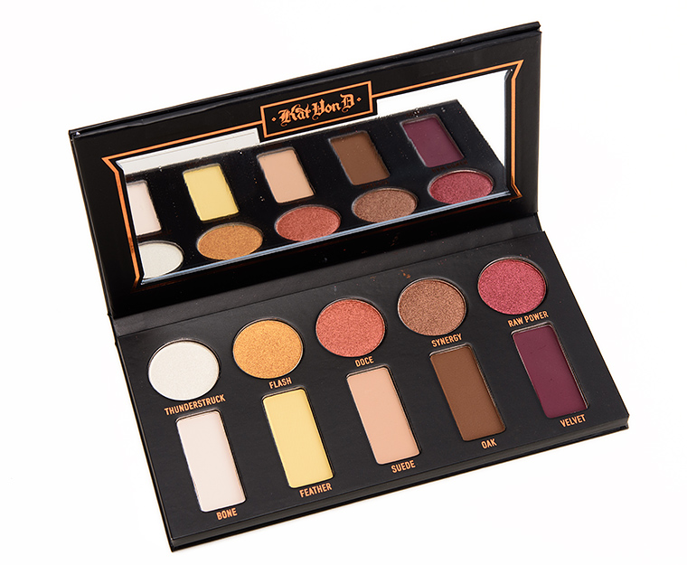
Recommendations and Favorite Products

Slide 34
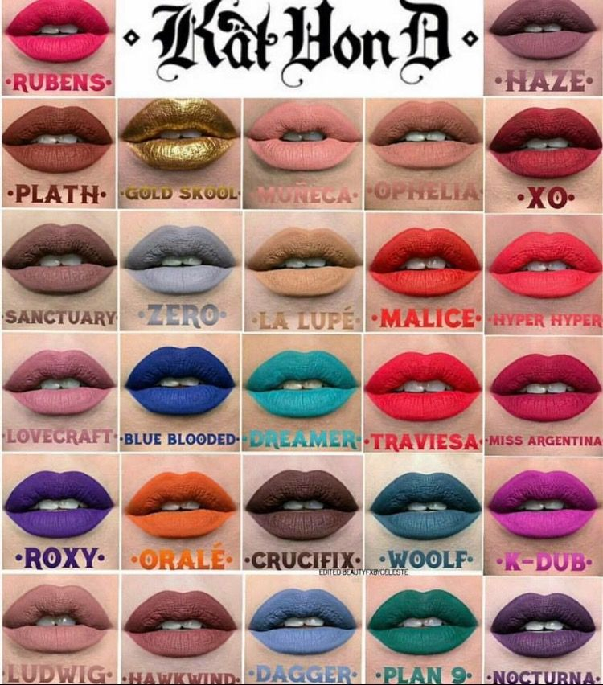
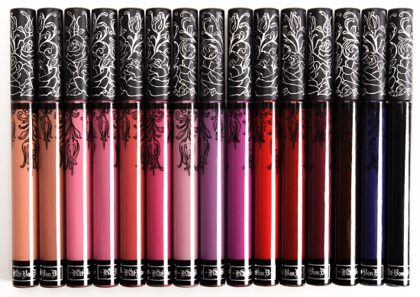
Recommendations and Favorite Products

Slide 35
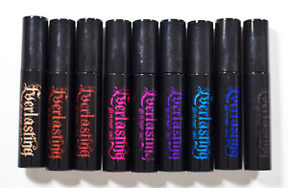
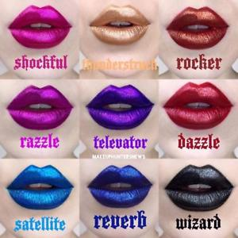
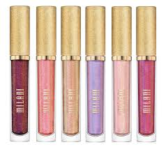
Recommendations and Favorite Products

Slide 36
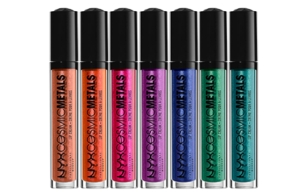
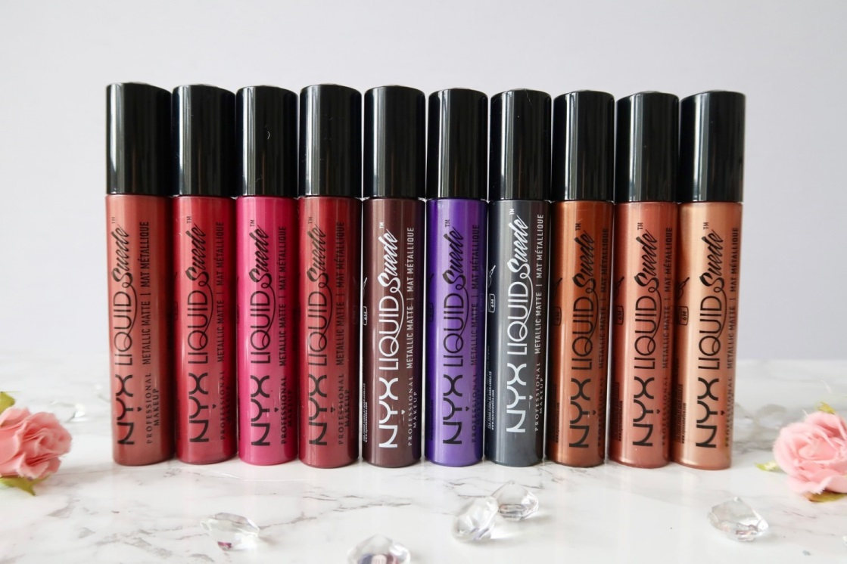
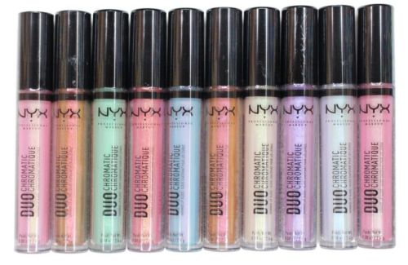
Recommendations and Favorite Products

Slide 37
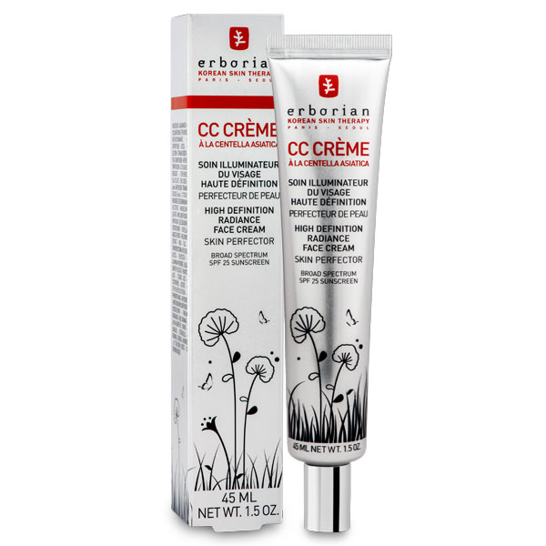
Recommendations and Favorite Products

Slide 38
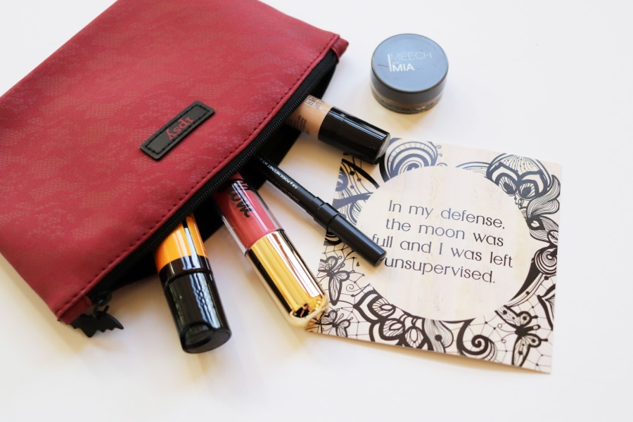
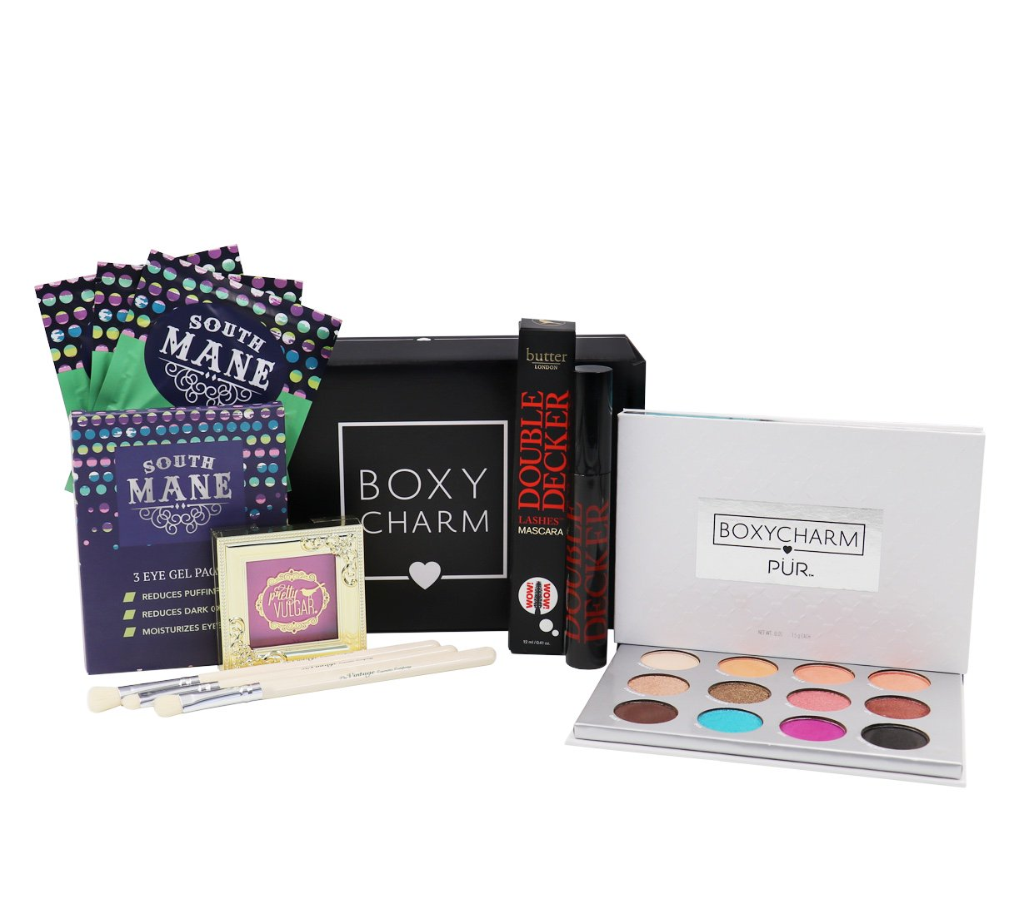
Recommendations and Favorite Products

Slide 39
Terms Not Appearing In This Film
BB Cream/CC Cream
Overspray
Dupe
T Zone
Oxidize
Flashback

Slide 40
What else….?
YouTube and Instagram Accounts?

Slide 41
Indie Brand Shoutout
Coloured Raine
Black Moon Cosmetics
Necromancy Cosmetica
Makeup Geek
Jeffree Star Cosmetics

